Slide 1
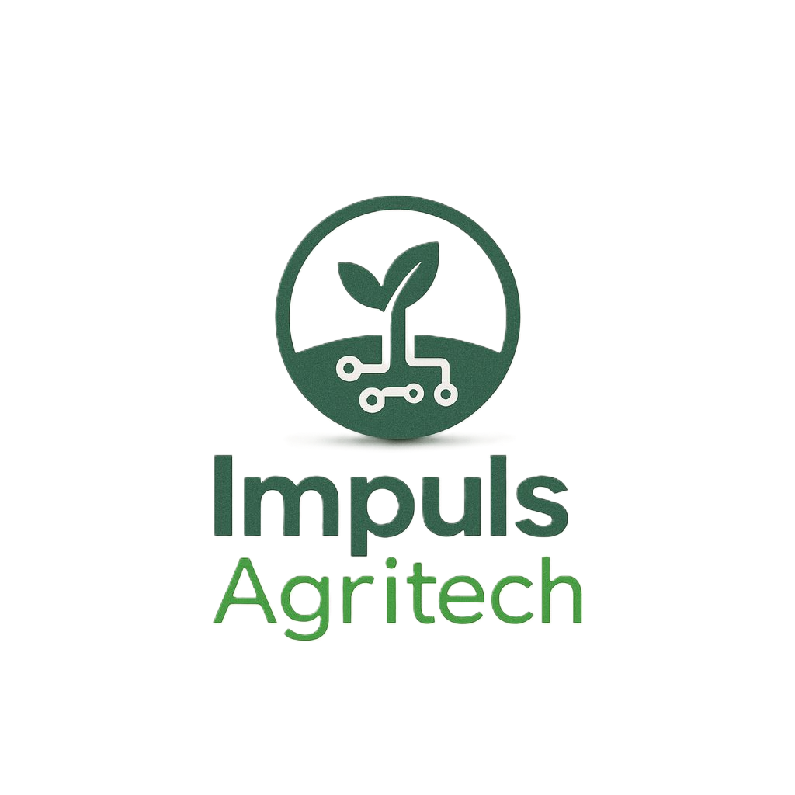
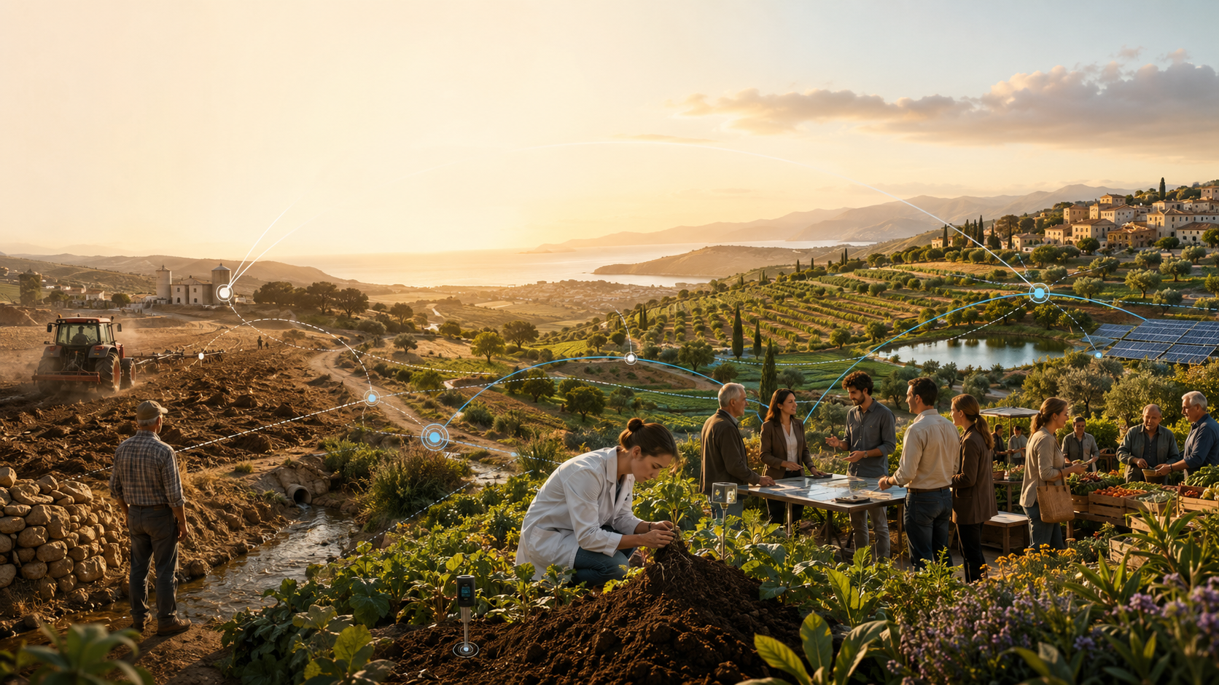

Impuls AgriTech Call 2026
Technology at the service of
systemic transformation
Session 1 of 2 · From complex food-system challenges to innovation ecosystems
- Jess Padilla (IRTA) -
Session 1 · Online · 17:00–18:30
Subvencionat pel Departament d'Empresa (Programa Primer) i amb el cofinançament del Fons Social
Europeu Plus

Slide 2
ORIENTATION
What we need to achieve in 90 minutes online
1 · Understand the problem
2 · Avoid the silver bullet trap
3 · Connect it to your project
Food systems are not a linear sector. They are ecological, social, technological, economic and political systems moving at the same time.
Innovation is essential, but no single technology fixes a systemic challenge. We need to ask what practices, incentives and relationships change.
Each startup can be read as a systems intervention: what it changes, who must adopt it, and what ecosystem conditions are required.
By the end of the session you should be able to describe your project not only as a solution, but as a hypothesis about how the agri-food system could change.
Impuls AgriTech 2026 · Technology at the service of systemic transformation · Session 1
Session 1
Notes:
Timing: 4 minutes.
This is the route for the session. First, we need to understand the nature of the problem. Food systems are not a simple value chain where one actor makes a change and the rest follows automatically. Food connects land use, water, energy, biodiversity, labour, health, consumption, trade, culture, logistics and public policy.
Second, we will use the material from the course to avoid what I call the silver bullet trap. A silver bullet is the belief that one technology, one product, or one app can solve a systemic problem by itself. In reality, technology needs adoption, trust, regulation, finance, infrastructure and incentives.
Third, we will connect this directly to your projects. I do not want this to be only a macro lecture about planetary boundaries. I want each of you to leave with a more precise way of explaining what your project is trying to change in the system. That framing will be useful for your value proposition, pilots, partnerships, and eventually your pitch.

Slide 3
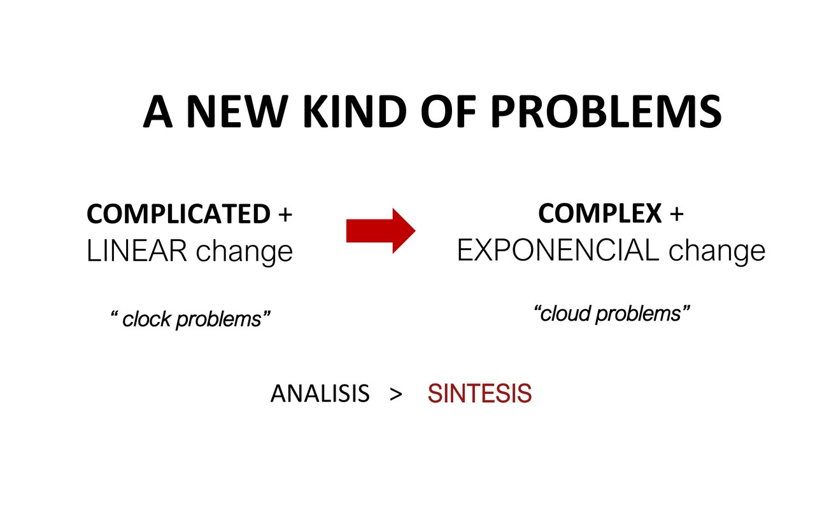
Notes:
Timing: 4 minutes.
This slide is a good entry point because it distinguishes complicated problems from complex problems. A complicated problem can be very difficult, but it is usually decomposable. If you have enough expertise and enough time, you can break it into parts, solve each part, and integrate the solution. Think about repairing a machine or calculating a technical specification.
A complex problem behaves differently. The system changes while we are acting on it. Actors learn, react, resist or adapt. There are feedback loops. There are delays. There are unintended consequences. This is why the slide contrasts clock problems with cloud problems. A clock can be disassembled and reassembled. A cloud cannot.
Agri-food transformation is closer to a cloud problem. If we improve yields, we may affect land use, prices, labour and biodiversity. If we introduce a new digital tool, adoption depends on trust, data ownership, skills and business incentives. So the first mental shift is this: we are not just solving technical problems; we are intervening in complex systems.

Slide 4
SYSTEMS LENS
Food systems are socio-ecological-technical systems
A startup is rarely changing only one variable.
Ecology
Technology
Economy
soil · water · climate · biodiversity
data · biotech · robotics · processing
prices · risk · margins · incentives
Society
Governance
behaviour · trust · culture · labour
rules · standards · public procurement
Systemic question for every innovation: “What else must change for this to work?”
Impuls AgriTech 2026 · Technology at the service of systemic transformation · Session 1
Session 1
Notes:
Timing: 5 minutes.
This is the lens I want you to keep in mind throughout the course. Food systems are socio-ecological-technical systems. That means that ecological processes, technologies, business models, behaviours and governance rules are interconnected.
When you design a startup, it is tempting to focus only on the product. But in this course, and especially in this session, I want you to ask a wider question: what else must change for this innovation to work? For example, if you have a satellite-based irrigation recommendation, the technology might work perfectly, but farmers still need to trust the recommendation, pay for the service, have connectivity, and maybe change routines that have been built over years. If you have a bio-input, the product needs evidence, distribution, farmer education, regulatory clarity and integration into agronomic practice.
So we will not treat startups as isolated inventions. We will treat them as hypotheses about system change. A startup says: if this solution is adopted by these actors, under these conditions, then this practice could change and a better outcome could emerge.

Slide 5
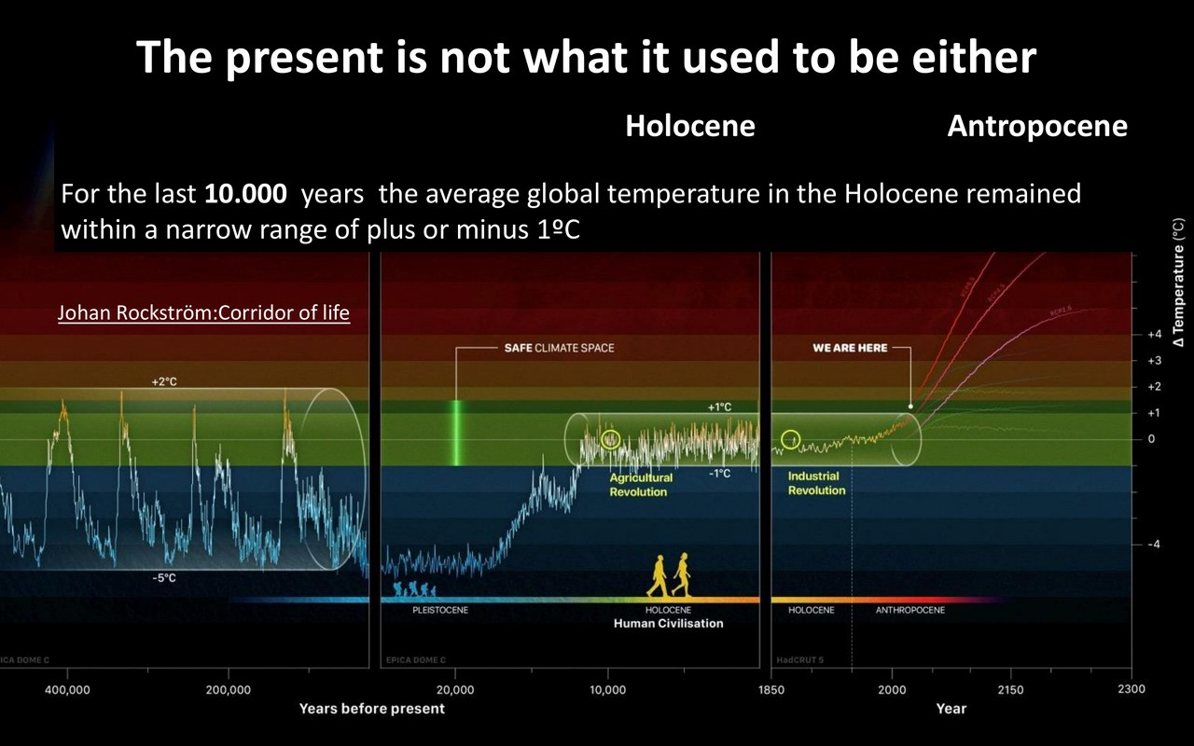
Notes:
Timing: 4 minutes.
This slide moves from the general idea of complexity to the planetary context. For most of human agricultural history, societies developed under relatively stable Holocene conditions. That stability supported the expansion of agriculture, settlements, trade and eventually industrial food systems.
The Anthropocene means that human activity has become a major force changing the conditions of the biosphere. For food and agriculture, this is not an abstract concept. Climate instability affects yields, pest pressure, water availability, soil conditions and the economics of farming. It also changes the risk profile for investors, insurers, cooperatives and public administrations.
For entrepreneurs, the practical message is this: the baseline is moving. You are not building solutions for a stable, predictable agricultural world. You are building for a world where uncertainty, adaptation and resilience are becoming core design requirements.

Slide 6
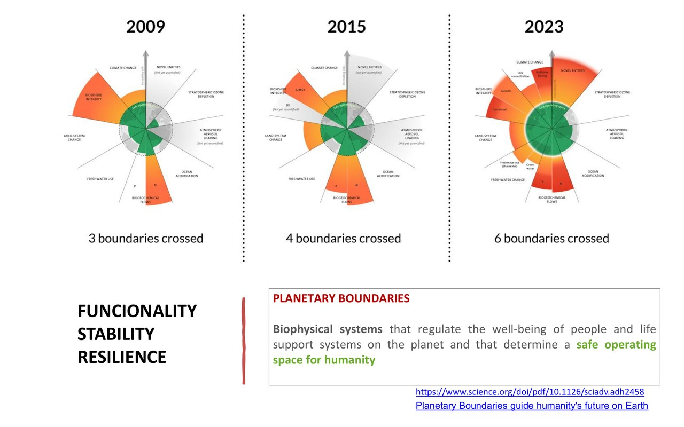
Notes:
Timing: 5 minutes.
Planetary boundaries are a way to describe the biophysical systems that regulate the stability and resilience of the planet. You do not need to be an expert in every boundary to understand why this matters for agri-food innovation. Food systems are deeply connected to several of them: climate change, land-system change, freshwater use, nitrogen and phosphorus cycles, biodiversity and chemical pollution.
This is why transformation is not only about producing more. Producing more can be necessary in some contexts, but the central challenge is producing, distributing and consuming food in a way that stays within a safe operating space and also meets human needs.
A good transition project needs to understand which boundary or pressure it is linked to. Are you reducing fertiliser loss? Are you improving soil health? Are you reducing food waste? Are you helping farmers adapt to water scarcity? Are you enabling better data for regenerative practices? The more precisely you can connect your solution to a systemic pressure, the stronger your opportunity analysis becomes.

Slide 7
ENTREPRENEURIAL LENS
What this changes for agri-food entrepreneurs
The opportunity is not “sell technology to agriculture”. The opportunity is to help the system adapt, regenerate and coordinate.
Risk
Climate, water, soil, regulation and market volatility increase uncertainty.
Evidence
Claims need proof: impact, agronomic performance, user value and economic viability.
Adoption
The user is not always the payer, and the buyer is not always the beneficiary.
Coordination
Pilots need farmers, cooperatives, corporates, public actors, researchers and investors.
A strong project describes both a value proposition and a system-change hypothesis.
Impuls AgriTech 2026 · Technology at the service of systemic transformation · Session 1
Session 1
Notes:
Timing: 5 minutes.
Let us translate the planetary discussion into entrepreneurial language. The opportunity is not simply to sell technology to agriculture. The opportunity is to help the system adapt, regenerate and coordinate.
There are four implications. First, risk is increasing. Climate variability, water scarcity, soil degradation, regulation and market volatility create new problems, but also new demand for solutions. Second, evidence matters. In agri-food, claims cannot remain abstract. You need agronomic evidence, user evidence, economic evidence and, if you claim impact, impact evidence. Third, adoption is difficult. The person who uses the solution may not be the person who pays. The actor who benefits may not be the actor who needs to change behaviour. Fourth, coordination is essential. Very few agri-food innovations can be validated alone. You need access to fields, data, partners, channels and credibility.
So throughout the course, I would encourage you to present your project in two layers: the value proposition for a specific customer, and the system-change hypothesis behind it.

Slide 8
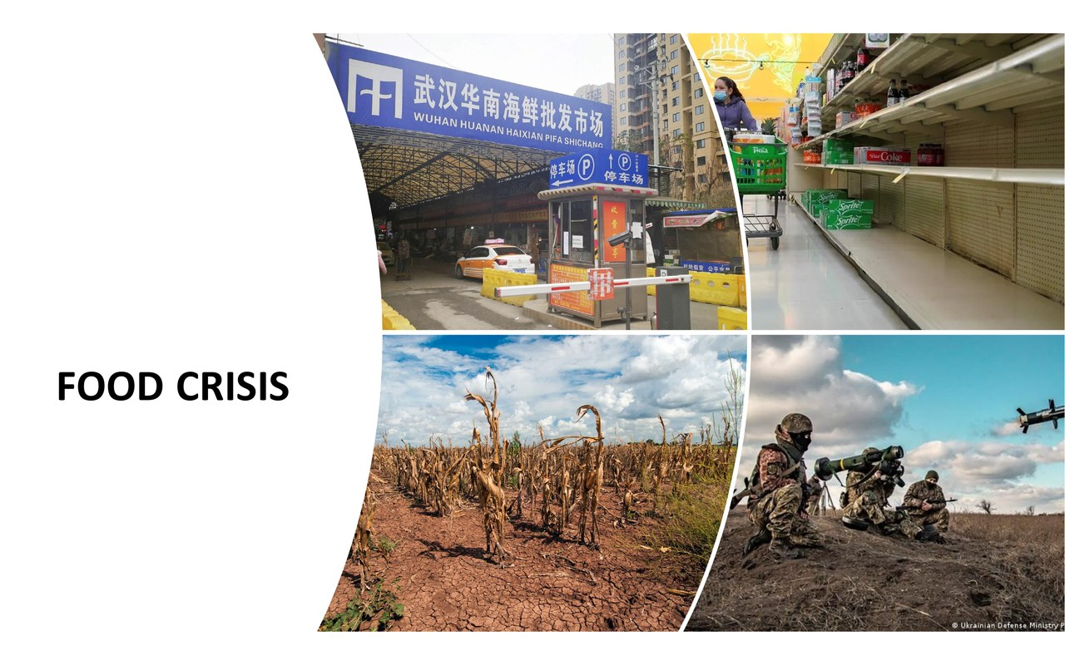
Notes:
Timing: 2 minutes.
We now move into the food crisis block. I will not treat this as a separate crisis from the planetary context. Food crisis, climate crisis, biodiversity crisis and social inequality are connected. Food systems are both affected by these crises and also contribute to some of the pressures behind them.
This is important because it means that food innovation cannot be reduced to one performance metric. More output, lower price or better convenience may be valuable, but they are not enough if they intensify other problems. This is why we need a systems view.

Slide 9
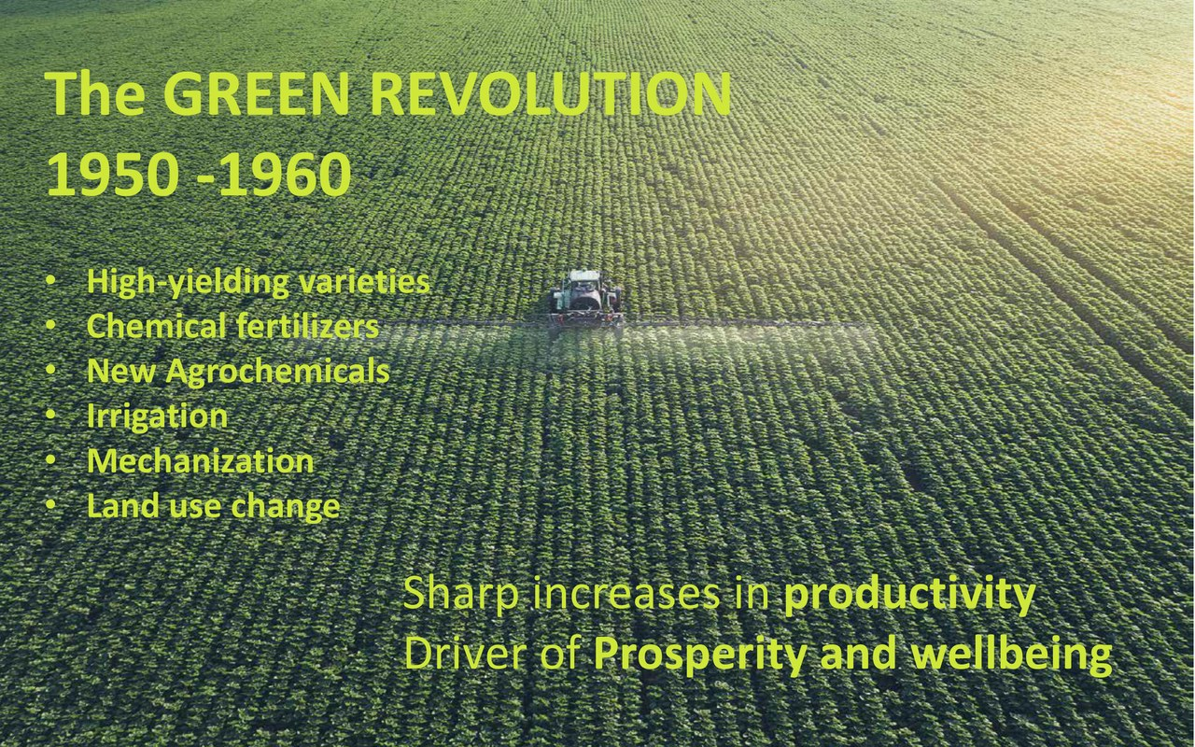
Notes:
Timing: 4 minutes.
The Green Revolution is a very useful example because it shows how powerful innovation can be, but also how historical solutions can create future tensions. High-yielding varieties, fertilisers, agrochemicals, irrigation, mechanisation and land-use change dramatically increased production. This contributed to food availability and human prosperity in many places.
But the same model also created dependencies and externalities: energy-intensive inputs, water pressure, soil degradation, biodiversity impacts, concentration in some value chains and vulnerability to input prices. The point is not to say that the Green Revolution was simply good or bad. The point is more subtle: innovation can solve urgent problems while creating new lock-ins.
For founders, this is a cautionary lesson. When you design an innovation, ask not only what problem it solves now, but what dependencies it creates for the future.

Slide 10
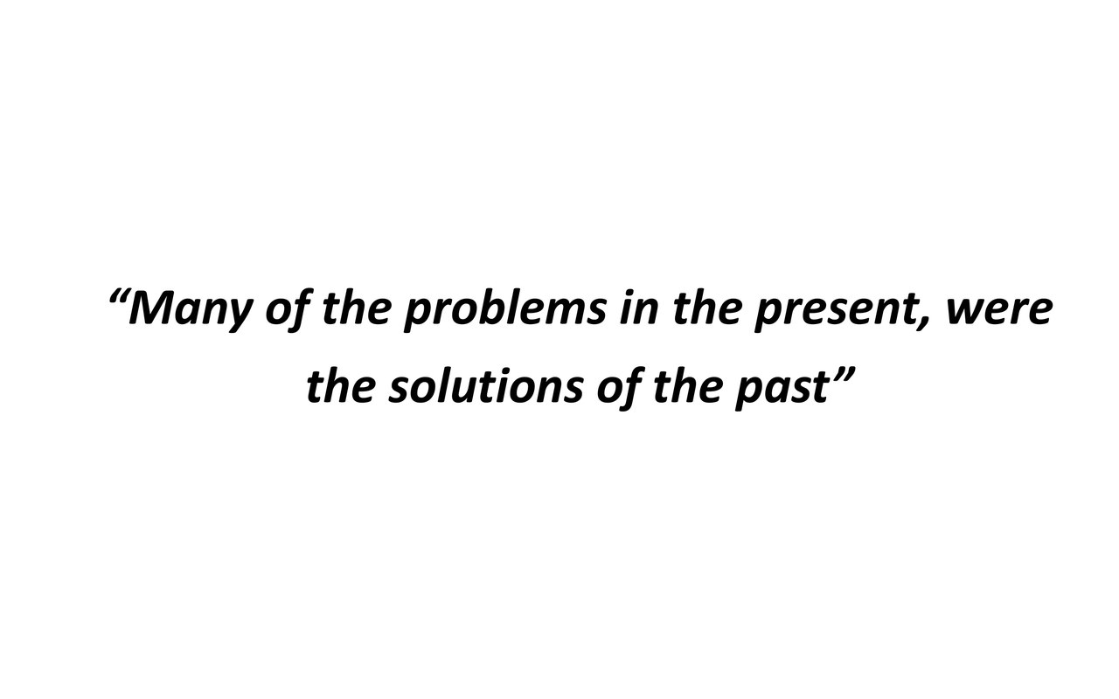
Notes:
Timing: 3 minutes.
This quote is one of the most important ideas in the session: many problems in the present were the solutions of the past. This is not a reason to reject innovation. It is a reason to innovate more carefully.
Every solution has a theory of change, even if we do not make it explicit. It assumes which actors will behave differently, what incentives will appear, what practices will disappear, and what impacts will follow. When those assumptions are wrong or incomplete, we get unintended consequences.
So when you present your project, do not only say: we solve problem X. Also say: we are aware of the system we enter, and we are designing for adoption, resilience and responsible scaling.

Slide 11
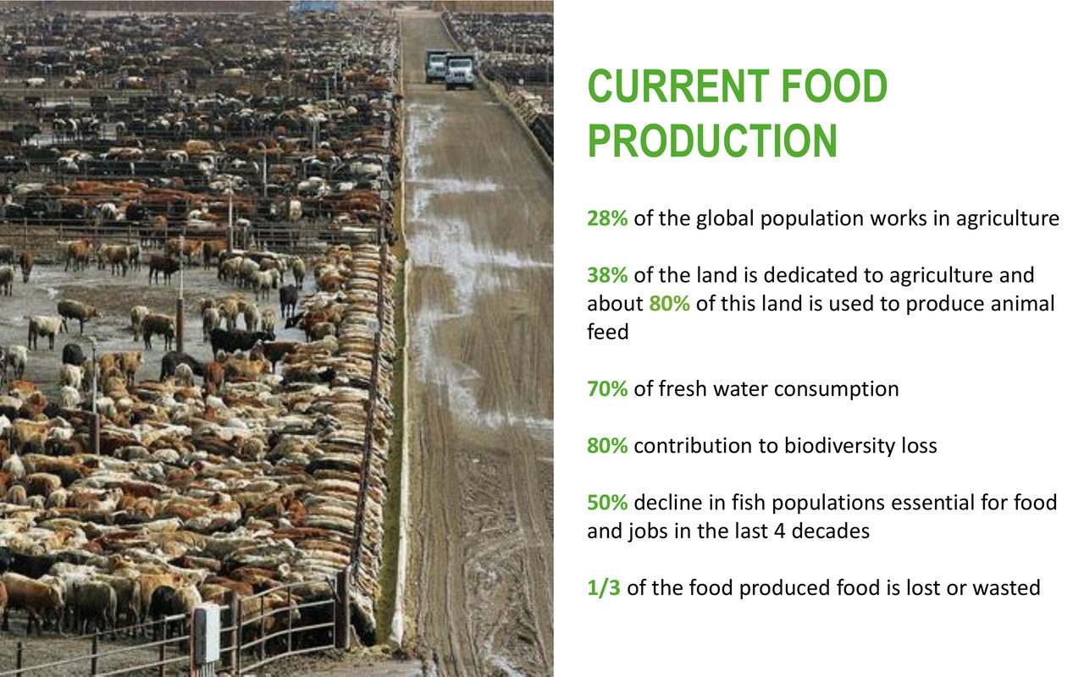
Notes:
Timing: 4 minutes.
This slide gives the scale of the current food-production system. The exact numbers matter less than the pattern: agriculture is a major user of land and water, it shapes biodiversity, it is linked to livelihoods, and it sits at the centre of environmental and social tensions.
For entrepreneurs, scale creates two messages. One: the opportunity space is enormous. Small improvements in resource efficiency, waste reduction, soil health or decision-making can matter when applied at system scale. Two: the adoption challenge is also enormous. Agriculture is not a single market. It is fragmented by crops, geographies, farm sizes, regulations, value chains, cultures and business models.
This is why we need to connect innovation to specific contexts. A solution for Mediterranean small farms is not the same as a solution for industrial grain production. A solution for cooperatives is not the same as a solution for individual consumers.

Slide 12
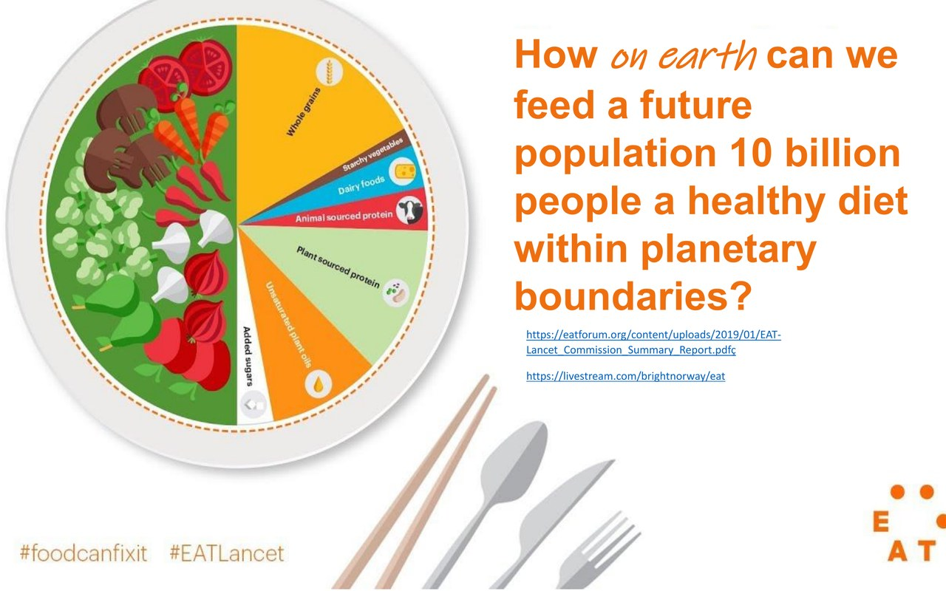
Notes:
Timing: 4 minutes.
This is the big challenge: how do we feed a future population a healthy diet within planetary boundaries? I would rephrase it for this course as an innovation question: how do we create viable ventures that help food systems become more sustainable, resilient and just?
Notice the tension: healthy diet, future population, planetary boundaries. This is not only an efficiency problem. It is also a distribution problem, a behaviour problem, a governance problem and a business-model problem.
That is why your projects can enter the challenge from different angles. Some of you work on data and decision support. Some on bio-inputs. Some on processing and upcycling. Some on platforms, communities, robotics or finance. These are different doors into the same systemic challenge.

Slide 13
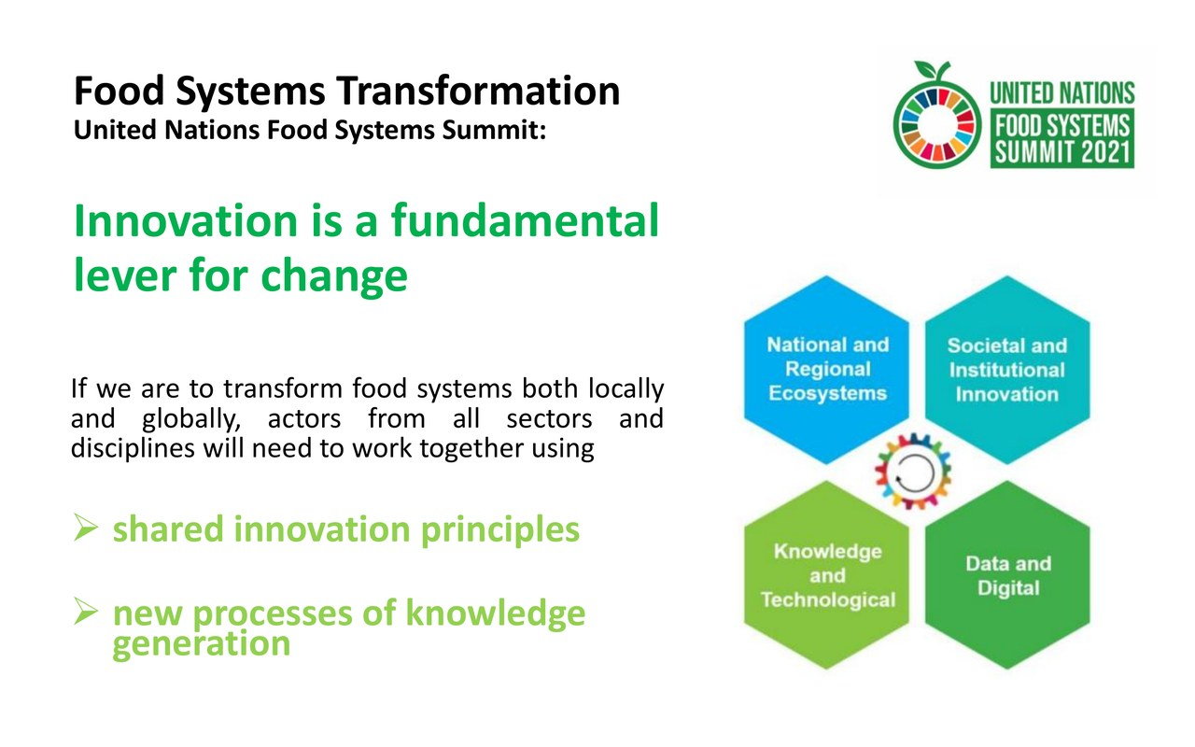
Notes:
Timing: 4 minutes.
This slide introduces innovation as a lever for change. I agree with that, but I want to add a precision. Innovation is a lever when it changes behaviour, practices, relationships and incentives. It is not a lever just because it is new.
This is especially important in agri-food because the distance between invention and transformation can be very large. A lab result is not a changed farming practice. A prototype is not adoption. A pilot is not a market. A sustainability claim is not impact evidence.
So the word innovation should be used carefully. In this course, innovation means the process through which new combinations of technology, knowledge, business models and partnerships create value and change the way the system works.

Slide 14
OPEN INNOVATION
Innovation is a lever only when the ecosystem moves
Invention
Pilot
Adoption
Scaling
System change
Evidence
Does it work in context?
Users
Who changes behaviour?
Channels
Who reaches the market?
Rules
What standards apply?
Capital
Who funds the valley?
Trust
Who gives credibility?
This is why open innovation matters: startups need partners to test, validate, access users, build trust and scale.
Impuls AgriTech 2026 · Technology at the service of systemic transformation · Session 1
Session 1
Notes:
Timing: 5 minutes.
This is the bridge between today and the second session. Innovation becomes transformative only when the ecosystem moves. There is a path from invention to pilot, from pilot to adoption, from adoption to scaling, and from scaling to system change. At each step, the bottleneck is different.
At the invention stage, the main question is: does the technology work? At the pilot stage, the question becomes: does it work in the real context, with real users and real constraints? At the adoption stage, the question is: who changes behaviour, who pays, who benefits, and what friction prevents adoption? At the scaling stage, the questions are about channels, regulation, trust, financing and operations.
This is why open innovation matters. Startups usually do not control the whole pathway. They need partners: farmers, cooperatives, corporates, research centres, public administrations, accelerators, investors and sometimes regulators. The quality of your ecosystem strategy can be as important as the quality of your technology.

Slide 15
YOUR PROJECTS
This cohort already covers several intervention types
Digital, AI & data
Bioinputs, processing & circularity
AgroVibe · Digital Phenotyping · SA.TECH · Siembre · Zertifarm
Alganova · Coldpress/Ingredaria · Mediterráneo Food
Platforms, communities & territory
Robotics & service models
BO · Micofora · Rootal
Cooptera
Different technologies, same strategic question:
What adoption pathway turns your project into a real change in practice?
Impuls AgriTech 2026 · Technology at the service of systemic transformation · Session 1
Session 1
Notes:
Timing: 4 minutes.
This slide connects the activity to the actual cohort. Since I will have met many of you yesterday during the IDEA PITCH, I want to use this as a bridge between what you pitched and the system lens we are building today. You are working on very different projects, but all of them can be interpreted as interventions in the agri-food system. Some projects are mainly digital, data or AI-based. Some are bio-based, circular or processing-related. Some are platforms, communities or territorial tools. Some are robotics or service-model innovations.
But despite the diversity, the strategic question is similar: what adoption pathway turns the project into a real change in practice? For a digital tool, the pathway may involve integration with existing farm-management platforms, trusted advisors or cooperatives. For a bio-input, it may involve demonstration plots and distributor relationships. For a platform, it may involve community activation and trust. For robotics as a service, it may involve cooperative economics and operational reliability.
This is the reason I want you to think beyond the product. Your project category gives you a first clue about which ecosystem partners are critical.

Slide 16
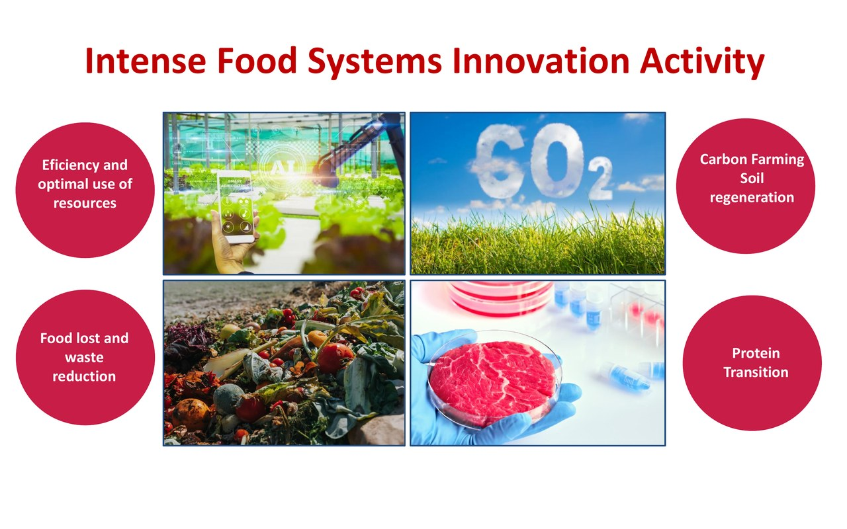
Notes:
Timing: 3 minutes.
The existing material identifies several areas of intense innovation activity: efficiency and resource optimisation, carbon farming and soil regeneration, food loss and waste reduction, and the protein transition. These are not isolated trends. They are responses to systemic pressures.
As you listen to this list, connect your project to one or more of these spaces. Are you improving the use of resources? Are you creating better data for soil or carbon practices? Are you reducing waste or creating new value from by-products? Are you shifting production systems or value chains?
The more clearly you locate your project in the wider transformation landscape, the easier it becomes to explain why it matters beyond its immediate customer.

Slide 17
FROM INVENTION TO MARKET
Technology clusters need adoption conditions
Examples from the course material
Data / AI / satellites
integration, trusted advice, data rights, connectivity
Biotech / bioinputs
field evidence, regulation, distribution, agronomic fit
Circularity / upcycling
supply consistency, processing partners, consumer trust
Regenerative / soil
measurement, incentives, long cycles, credible claims
Your next pilot should test both the technology and the adoption condition.
Impuls AgriTech 2026 · Technology at the service of systemic transformation · Session 1
Session 1
Notes:
Timing: 5 minutes.
This is a practical way to move from macro transformation to startup strategy. Every technology cluster has a corresponding set of adoption conditions. If you work with data, AI or satellites, the adoption bottleneck may not be the algorithm. It may be integration, trusted advice, data rights or connectivity. If you work with bioinputs, the adoption bottleneck may be field evidence, regulatory pathways, distribution and agronomic fit.
If you work with circularity or upcycling, the bottleneck may be supply consistency, processing capacity, partnerships or consumer trust. If you work with regenerative agriculture or soil data, the bottleneck may be measurement, incentives, long time horizons and credible claims.
So when you design a pilot, test the adoption condition, not only the technology. For example: can we get a cooperative to recruit ten farmers? Can a distributor explain the value proposition? Can a farmer understand the dashboard in five minutes? Can a buyer trust our data? These are ecosystem questions, and they often determine whether a good solution becomes a real venture.

Slide 18
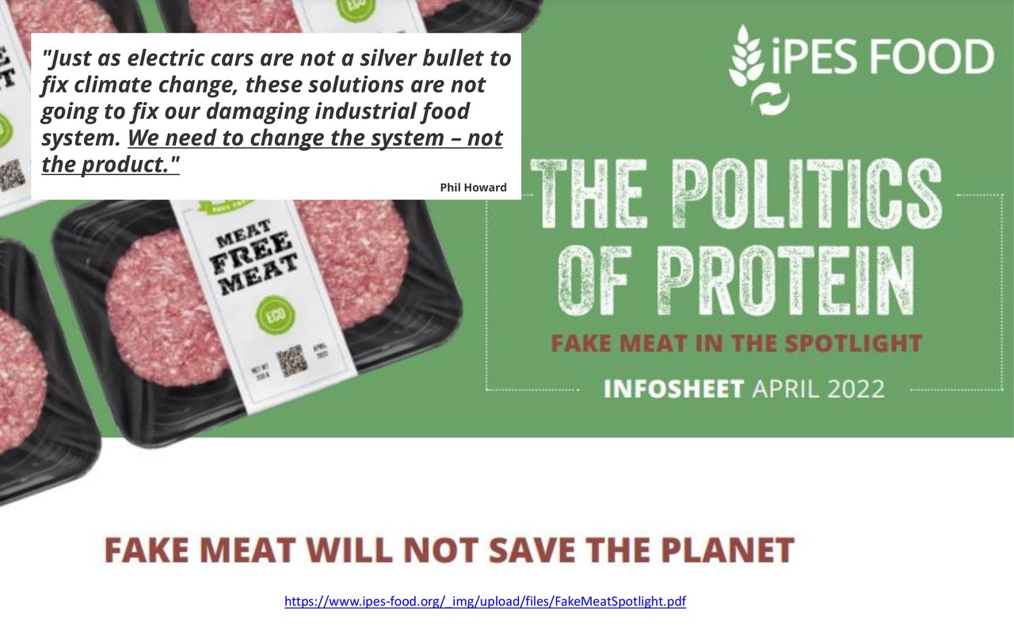
Notes:
Timing: 4 minutes.
This quote is useful because it challenges a common innovation narrative. The protein transition is important, and alternative proteins can be part of a more sustainable food system. But replacing one product with another does not automatically transform the system. It may reproduce similar problems if ownership, supply chains, processing models, land use, nutrition, access or labour conditions remain unchanged.
The broader lesson is not limited to protein. Digital tools can also become silver bullets. Bioinputs can become silver bullets. Carbon farming can become a silver bullet. Any innovation can be framed as “the solution” when it is actually only one element in a wider transition.
For your projects, the question is: how do we avoid overclaiming? How do we explain the specific contribution of the innovation without pretending it fixes everything? A credible systemic entrepreneur is ambitious, but precise.

Slide 19
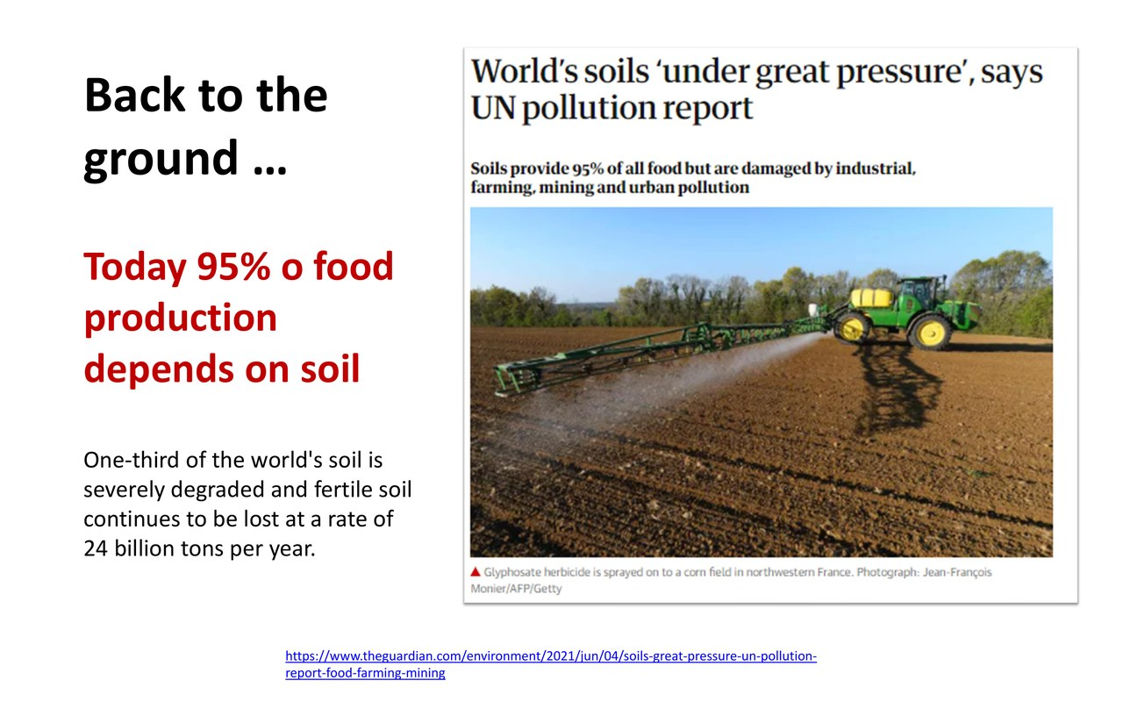
Notes:
Timing: 3 minutes.
This slide brings us back to the ground, literally. Soil is a useful reminder that food systems are not only digital, financial or industrial systems. They are living systems. Many innovations in agri-food ultimately depend on biological processes that have their own rhythms and limits.
This matters for venture design. Some outcomes cannot be validated in one week. Soil health, biodiversity, resilience and farmer trust may take time. That does not mean they cannot become business opportunities. It means the business model, evidence strategy and financing pathway must respect the biology and the adoption cycle.

Slide 20
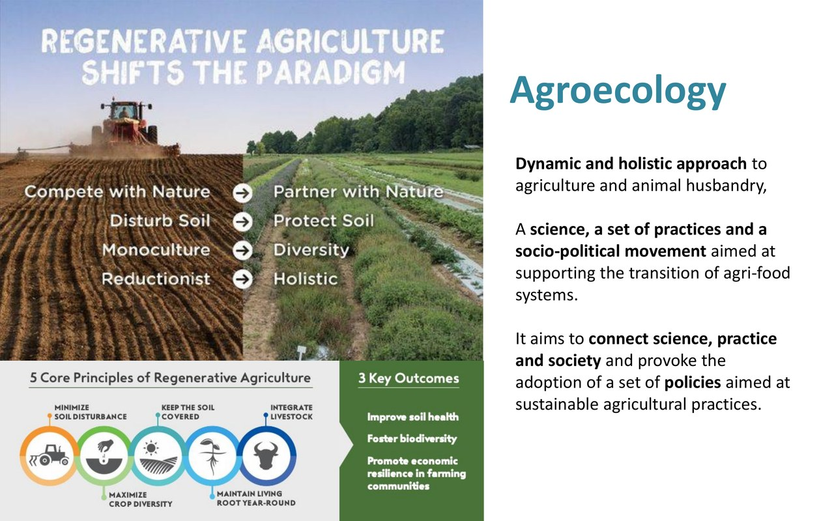
Notes:
Timing: 3 minutes.
Agroecology is presented here as science, practice and socio-political movement. Whether or not your project uses the word agroecology, the idea is useful because it reminds us that knowledge is distributed. Farmers have practical knowledge. Researchers have experimental knowledge. Startups have technological and business-model knowledge. Public actors have regulatory and territorial knowledge.
An innovation ecosystem works when these forms of knowledge can interact. In the next session we will go deeper into how to design those interactions through open innovation, pilots, living labs and shared agendas.

Slide 21
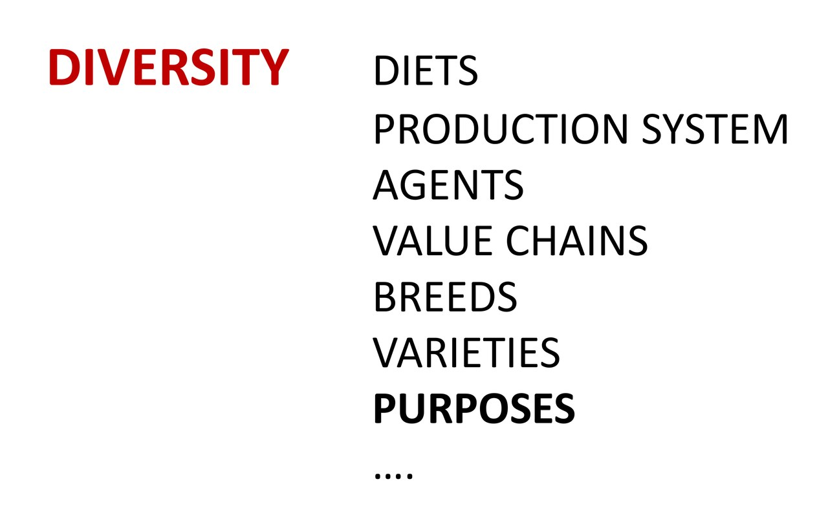
Notes:
Timing: 3 minutes.
This slide is about diversity: diets, production systems, agents, value chains, breeds, varieties and purposes. Diversity is not only a nice value. It is a resilience principle. Systems with more useful diversity tend to have more ways to adapt when conditions change.
For startups, this means that scaling should not always mean imposing one identical model everywhere. Sometimes scaling means adapting a solution to different contexts, crops, farm structures, regions and partners. This is especially relevant in Mediterranean agriculture, where farm size, water pressure, cooperative structures and territorial identity matter.

Slide 22
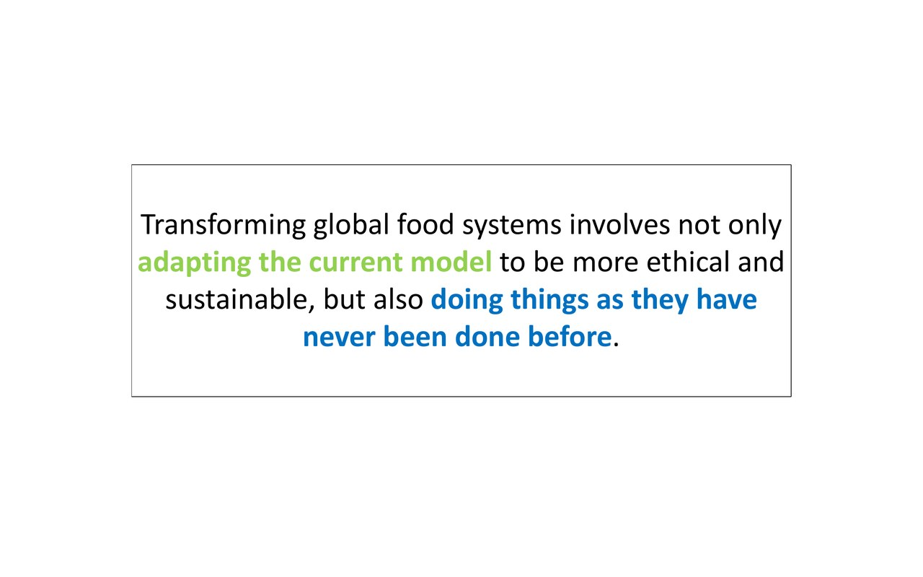
Notes:
Timing: 4 minutes.
This is where I would like to close the conceptual part of the first session. Transforming global food systems is not only about making the current model slightly cleaner, more ethical or more efficient. It is also about doing things differently, sometimes in ways that have not been done before.
But this sentence creates the question for the next session: how do we make the new possible? It is not enough to have a good idea. It is not enough to have a prototype. To do things differently, we need ecosystems that can test, validate, adopt and scale new practices.
So today we have looked at the food-system challenge. Next time, we will look more directly at the innovation challenge: how to move from isolated startups to ecosystem-level transformation.

Slide 23
TASK PREVIEW
Phase 1: read your project through Three Horizons
No live task today — keep these questions in mind for the final deliverable.
1
H1 · Business as usual
What current practice, inefficiency or lock-in is your project challenging?
2
H3 · Desired future
What better practice, relationship or system condition do you want to help create?
3
H2 · Your disruption
How can your project help move from H1 to H3?
4
Risk of capture
How could your innovation reinforce H1 instead of enabling H3?
No live submission today.
Final deliverable: Three Horizons + Ecosystem Lens, submitted after both sessions.
Impuls AgriTech 2026 · Technology at the service of systemic transformation · Session 1
Session 1
Notes:
Timing: 15 minutes total.
Introduce the activity slowly: We will now stop the presentation for a few minutes and apply the systems lens to your own projects. Please do not try to write a perfect answer. The objective is to make your assumptions visible.
First, answer the four questions individually. Give them about seven minutes. Then ask them to compare with one person next to them for five minutes. After that, invite two or three people to share one sentence.
You can say: I am not asking you to describe your product. I am asking you to describe what your product tries to change. For example, not “we provide satellite data,” but “we help small farmers shift from reactive irrigation decisions to evidence-based water management.” Not “we sell a bio-input,” but “we help growers reduce dependence on inefficient fertiliser use while maintaining yield.” The output is one sentence that begins: “Our project changes the system by…”

Slide 24
STUDENT TASK
How Session 1 connects with Session 2
The final task has two phases. You do not need to complete it during today’s class.
Phase 1 · Three Horizons
After today: describe H1, H3, H2 and the risk of capture for your project.
Session 2 · Ecosystem Lens
Tomorrow: we will add actors, bottlenecks, partners, evidence and adoption conditions.
After Session 2 · Complete task
Finish the ecosystem questions and the final sentence.
Optional preparation
Watch the “Three Horizons: an introduction” video and start thinking about your H1, H3 and H2.
Core bridge
Session 1 = what needs to change. Session 2 = who needs to move for adoption to happen.
Impuls AgriTech 2026 · Technology at the service of systemic transformation · Session 1
Session 1
Notes:
Timing: 4 minutes.
To close, give them a very concrete task. Ask them to bring a one-page draft for the second session. It is not a formal deliverable yet. It is a working document to make the next session more useful.
They should answer five questions. First: what is business as usual in the part of the system they are entering? Second: what desired future do they want to support? Third: how could their innovation be captured by the old system, and how could it instead enable the new one? Fourth: what is their ecosystem hypothesis: which actors must be involved for adoption to happen? Fifth: what pilot experiment could they run with a real partner in the next 60 to 90 days?
End with this sentence: Today we looked at why transformation is necessary. Next time we will work on how innovation ecosystems can make transformation more possible, and how your projects can design better partnerships, pilots and adoption pathways.

Slide 25

Thank you!
Subvencionat pel Departament d'Empresa (Programa Primer) i amb el cofinançament del Fons Social Europeu Plus
impuls.agritech@gbsb.global
+34 930 086 588

