Slide 1



Impuls AgriTech Call 2025
Opportunity Analysis
Xavier Arola
Subvencionat pel Departament d'Empresa (Programa
Primer) i amb el cofinançament del Fons Social Europeu Plus

Slide 2
Opportunity Analysis
About me:
Academic Orientation:
  Economist with a specialization in Innovation, entrepreneurship, management, finance and strategy.
  Professional Experience:
  Executive positions in several private and public ventures.
  Mentor and consultant for public and private sectors.
      Xavier Arola
  xavier.arola@faculty-gbsb-global.org

Slide 3
Opportunity Analysis
  Professional Executive Experience NEW VENTURES:
  Creating and developing a newco of facility management in public facilities (ICF Equipements).
  Creating and developing a newco of managing cultural heritage. (ACdPC Catalan Heritage Agency).
  Founder and CEO of a Publishing & Contents Creation Company and other cultural ventures mixing funding, culture and resources (Edita.cat,..).
  Cofounder of e-transing.

Slide 4
Opportunity Analysis
  Professional Consultancy Experience in entrepreneurship:
  Mentor of startups in Accelerators/Investment Funds (Inno Energy, EIT FOOD, EIT UM).
  Consultant of new ventures in strategy, customer development and funding .
  Strategy & Energy and resources Accredited Consultant by ACCIÓ (Catalan Government)
  Head of CAEC at GBSB Global.
  Founder and Director of the G-Accelerator/GBSB.
  Founder and Director of Impuls Agritech

Slide 5
Opportunity Analysis
  · 3 Personal tips about me:
  1)…
  2)…
  3)…

Slide 6
Opportunity Analysis
9 Projects Selected
15 Beneficiaries
6 Nationalities
30% female- 70% male
About you:

Slide 7
Opportunity Analysis
TROCA | Marcos Cuenca
PILPIG | Pol Llagostera
 | Vicente Lopez
 | Yun Bao
GreenGuard | Paula Fuster
UPCxels | Gemma Anglada
 | Victor Barria
 | Miquela Alomar
Agrixels | Maribel Lozano
 | Javier Álvarez
Sweet Chlamy | Jae Seong
Microbial Solutions | Kostadin Evgienev
IPreFeR | Pol Llagostera
 | Vicente Lopez
 | Yun Bao
TerraArgus | Felipe Hernandez
 | Rafael Ripoll
 | Can Celikay
About you:

Slide 8
Opportunity Analysis
THE IMPULS AGRITECH 2025 IT'S FOCUS ON
Next generation entrepreneurs with INNOVATIVE AGRITECH ideas with TRIPLE IMPACT on:
Sustainable livestock farming ​
Genetic improvement and Biotechnology ​
Artificial Intelligence and Data Science ​
Sustainable Agronomy ​
Energy and Waste / by-product management

Slide 9
Opportunity Analysis
How we are going to do it?
  We are going to use techniques, exercises and templates
  to define our idea and to complete your LEAN CANVAS:
    MISSION / PURPOSE
    DIAGRAMA PERSONA (Buyer PERSONA)
    VALUE PROPOSITION CANVAS
    OCEAN BLUE STRATEGY
    ……
LEAN CANVAS

Slide 10
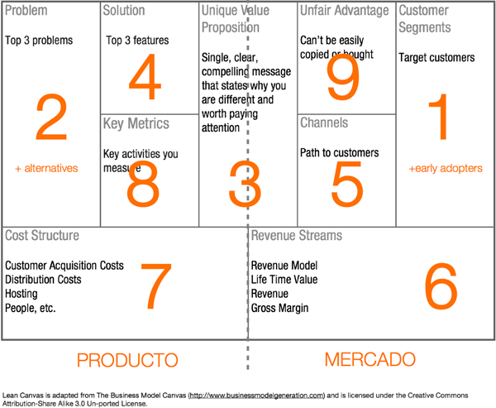
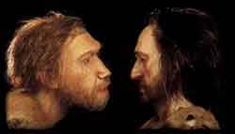
Opportunity Analysis
LET’S TRY TO REFLECT THIS IDEA THOUGHT THE LEAN CANVAS…

Slide 11
Opportunity Analysis
About you:

Slide 12
Opportunity Analysis
THE IKIGAI REFLECTION / THE MASSIVE TRANSFORMATION PURPOSE:
What do you love?
What does the world need?
Mission
Your Startup Project
Passion
Vocation
What are you good at?
What can you be paid for?
Profession

Slide 13
Opportunity Analysis
ALL THIS PROCESS START WITH YOU/ME…
HOW AM I?
WHAT I LIKE?
WHAT AM I GOOD AT?
AND THEN COMES YOUR PURPOSE / MISSION…

Slide 14
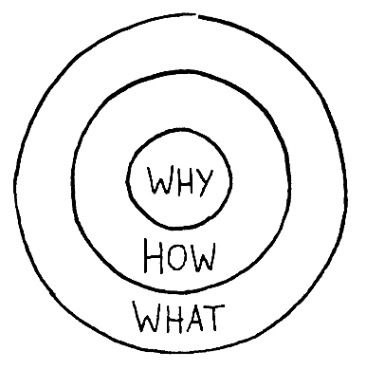
Opportunity Analysis
AND FROM THAT WE GOT THE WHY OF OUR START UP
    Defining a
    Purpose driven business

Slide 15

Opportunity Analysis
And also defining your STORYTELLING……
Simon Sinek
https://www.youtube.com/watch?v=4VdO7LuoBzM
Why? Inspiring leadership in companies is missing
Why for you? Inspire others to invest & attract customers
Use: Golden Circle

Slide 16
Opportunity Analysis
Law firm X
Example of the past:
What?
“Here is our law firm”
How?
“We have the industry’most intelligent
lawyers, who graduated from the top schools.
Our client list is only from Fortune 500!”
Why?
None: “Just come do business with us.”

Slide 17
Opportunity Analysis
Law firm Z
Why?
“We believe in servicing needs of others so that they can focus on the difference they need to make”
How?
“We do so by bringing on the most intelligent legal professionals who graduated from the world’s top school. We work with top performing organisations, most of which are on the Fortune 500 list, so that we can help them make a larger difference in the world.”
What?
“We are a world-class law firm. Come see for yourself.”

Slide 18

Opportunity Analysis
To organize the world's information and make it universally accessible and useful

Slide 19
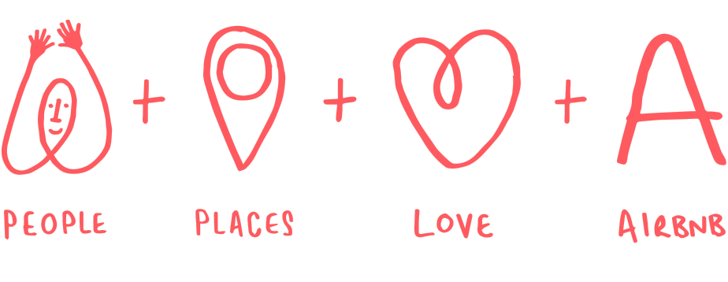
Opportunity Analysis
Help creating a world where you can belong anywhere

Slide 20
Opportunity Analysis
Money is the result, ​
not the purpose​
(your Why and Your storytelling it is…)

Slide 21
Opportunity Analysis
EXERCISE 1) DEFINE YOUR WHY, GET YOUR MISSION

Slide 22
Opportunity Analysis
https://canvanizer.com/new/lean-canvas
LET’S TRY TO REFLECT THIS IDEA THOUGHT THE LEAN CANVAS…

Slide 23
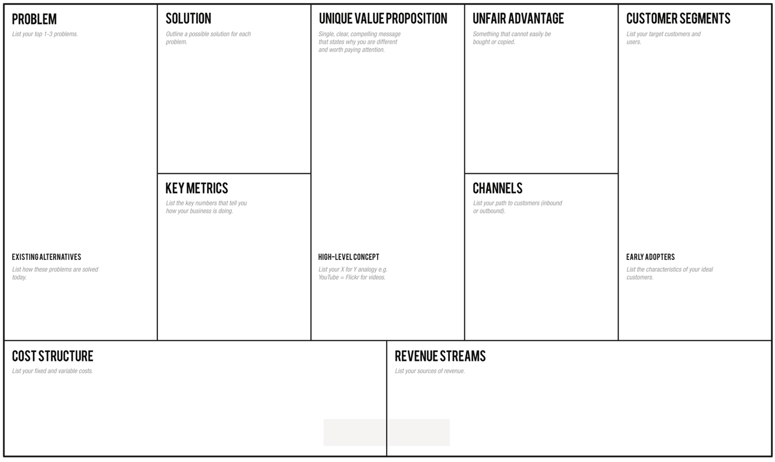
Opportunity Analysis
https://canvanizer.com/new/lean-canvas

Slide 24
Opportunity Analysis
SOME TIPS ABOUT MARKET SEGMENTATION
Customer groups represent separate segments if:
  Their needs require and justify a distinct offer
  They are reached through different Distribution Channels
  They require different types of relationships
  They have substantially different profit abilities
  They are willing to pay for different aspects of the offer

Slide 25
Opportunity Analysis
TYPES OF CUSTOMER SEGMENTS:
    Mass market: broadly similar needs and problems.
    Niche market: specialized Customer Segments.
    Segmented: distinguish between market segments with slightly different needs and problems.
    Diversified: serves unrelated Customer Segments with very different needs and problems.
    Multi-sided platforms (or multi-sided markets): interdependent Customer Segments.
What market do address our social or impact new venture?

Slide 26
Opportunity Analysis
EXERCISE 2) CUSTOMER SEGMENTS LIST

Slide 27
Opportunity Analysis
Let's start by the Customer Segments...
BRAINSTORMING: CREATING A NEW MARKET: WIDE LIST OF POTENTIAL MARKETS
THEN NARROWING (PBM/SOLUTION)
RESEARCH WITH POTENTIAL CUSTOMERS – EARLY ADOPTERS
FIRST MARKET SEGMENTATION CHART
FOCUS ON A SPECIFIC MARKET
DEFINING PAYING CUSTOMER
MARKET
SEGMENTATION
BEACHEADED
MARKET

Slide 28
Opportunity Analysis
EXERCISE 3) FROM MARKET SEGMENTATION TO THE BEACHEADED MARKET

Slide 29
Opportunity Analysis
SOME KEY QUESTIONS ABOUT CUSTOMER SEGMENTS
For whom are we creating value?
Who are our most important customers?

Slide 30
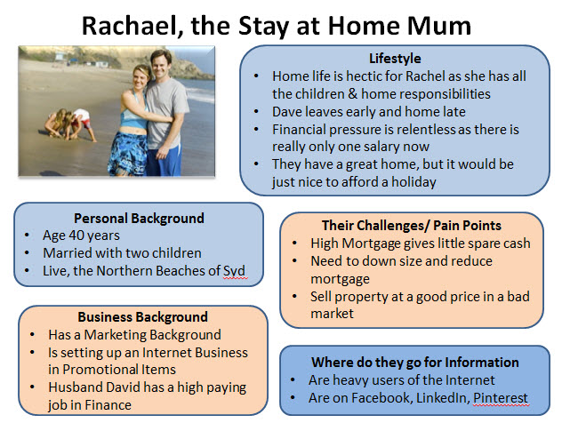
Opportunity Analysis
Let’s go to
the BUYER PERSONA description….
B2C Example

Slide 31
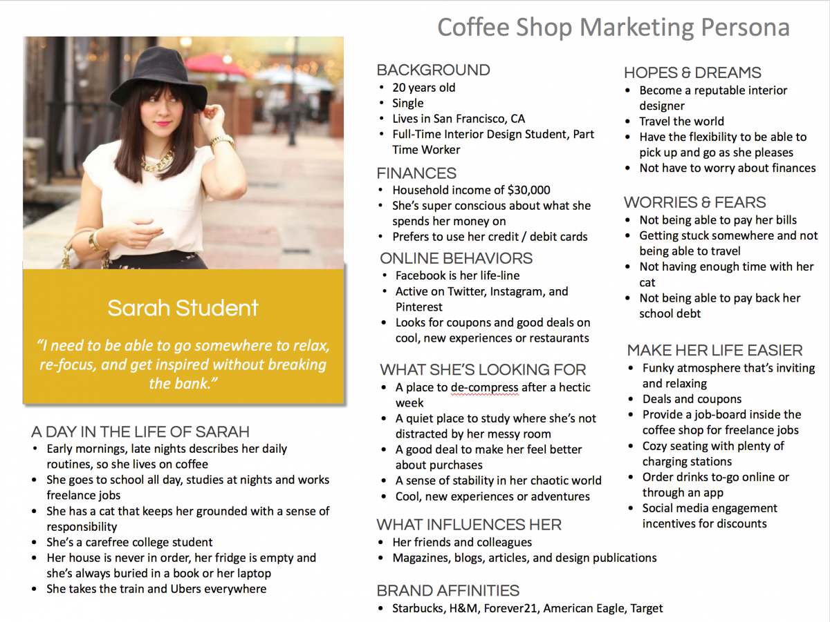

Opportunity
Analysis
B2C Example

Slide 32
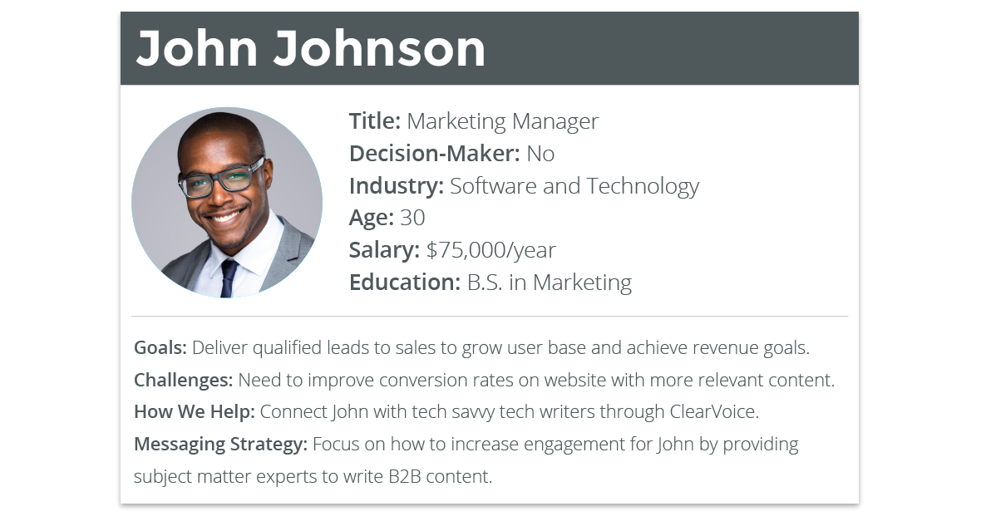
Opportunity Analysis
B2B Example

Slide 33
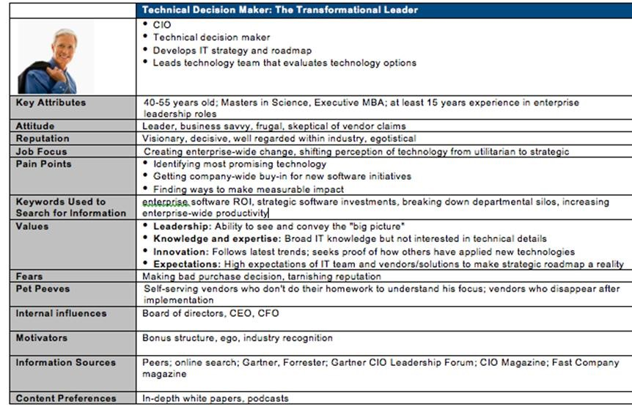
Opportunity
Analysis
B2B Example

Slide 34
Opportunity Analysis
EXERCISE 4) BUYER PERSONA TEMPLATE

Slide 35
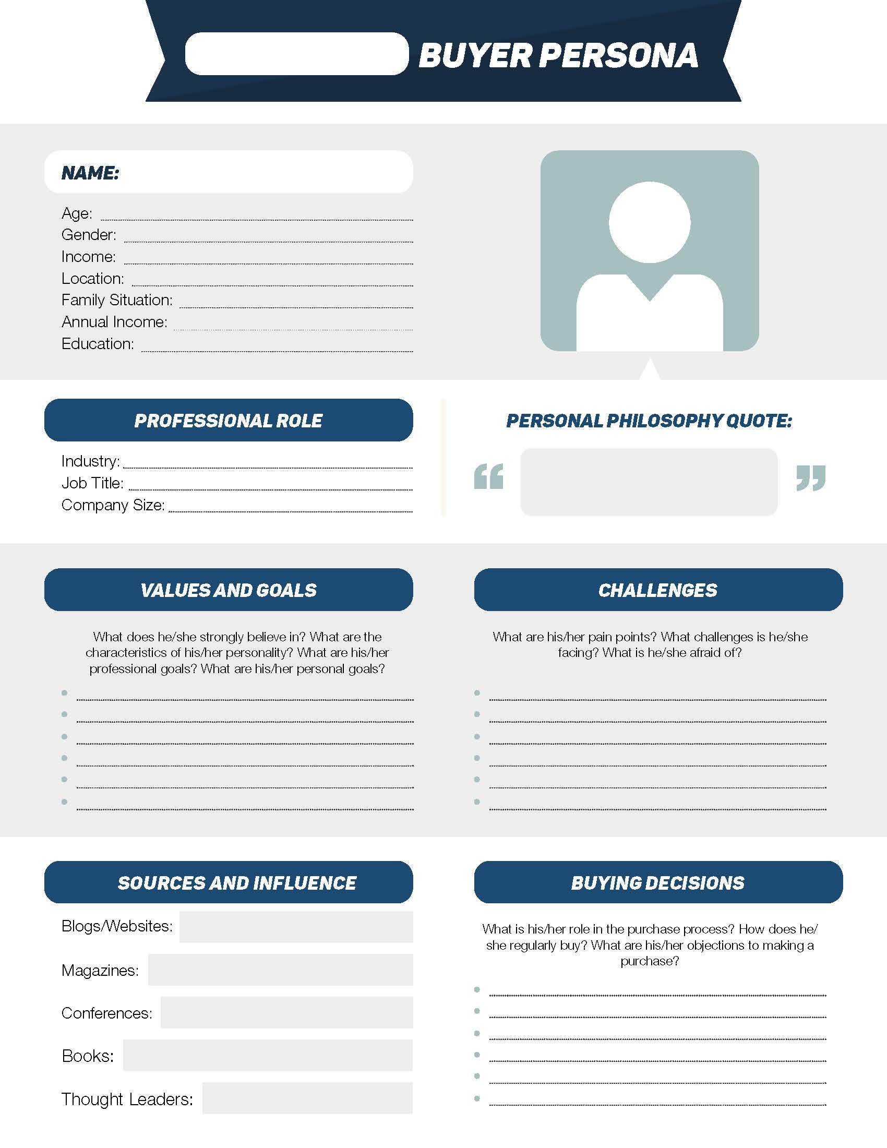
Opportunity Analysis

Slide 36

Opportunity Analysis
Let's develop your WHY and your BUSINESS IDEA together
DEFINE YOUR INNOVATION PROCESS
https://www.ideatovalue.com/inno/nickskillicorn/2016/03/innovation-15-experts-share-innovation-definition/

Slide 37

Opportunity Analysis
THIS IS THE FIRST PART
WE HAVE A PAYING CUSTOMER WHOM WE REALLY SOLVE PROBLEMS WITH OUR IDEA TROUGH OUR UNIQUE VALUE PROPOSITION

Slide 38

Thank you!
Subvencionat pel Departament d'Empresa (Programa
Primer) i amb el cofinançament del Fons Social Europeu Plus
g-accelerator@global-business-school.org
+34 930 086 588

