Slide 1



Impuls AgriTech Call 2025
Measure of the impact of our technologies
Chema Gil
Subvencionat pel Departament d'Empresa (Programa
Primer) i amb el cofinançament del Fons Social Europeu Plus

Slide 2



RESEARCH IMPACT
Bouali Guesmi & José María Gil Roig
02/10/2025

Slide 3

Index
Introduction to impact
Engaging and working with users of research Demonstrating impact
Developing an impact strategy

Slide 4
I-Introduction to impact
Content
An explanatory section covering what impact is (and what it isn’t), how to identify it, and general content on planning, user engagement, evidence and narratives.
Learning outcomes
To establish a basic understanding of impact, address myths and set a firm basis for more advanced topics.

Slide 5



Introductions
What are your goals for this course?
Discussion

Slide 6

WHAT IS IMPACT?

Slide 7


Impact =
Provable effects (benefits) of research in the ‘real world’
Effects felt here (outside academia)
Research
Academia
Society, environment, economy etc

Slide 8
Impact is change
Reduced, less, lower…
Mortality Waste Risk Cost
Staff turnover Stress Crime
Efficiency
Effectiveness Wellbeing Engagement Access
Profit Skills
(etc)
Includes STOPPING or PREVENTING
something
(etc)
Improved, more, faster, increased….
Not dissemination, academic interest or reputation, citations, attention

Slide 9
In Agri-Food Sector, for example…
New strategy
New jobs
New markets
Market share
Leveraged funding
Market position
Profits
Sales
Staff retention
Diversification
Improved equality
Upskilled staff
New products
Product regulation
New partnerships
New structure
Staff wellbeing
Improved decision making

Slide 10

Types of research impact
Capacity building
Change in the ability to do something
Conceptual
Change in the way something is thought about
Instrumental
Change in a thing

Slide 11
Impact can arise from
Findings: new knowledge somehow leading to change
The research process: where the practice of research (eg. co- production) can be a catalyst for change itself.
Any time, any location, any type, any route.

Slide 12




Outputs vs. knowledge mobilization vs. impact
Outputs
Things produced by the research (eg. articles, interventions)
Knowledge mobilization
Activities to connect (eg. outreach, partnership working, media)
Research impact
The provable benefits of research in the real world
Often measured by
bibliometrics (eg. citations, h-index etc) which show scholarly attention
Qualitative or quantitative
demonstrations of activity (eg. retweets, school visits, training given)
Qualitative or quantitative
evidence which shows real world change

Slide 13




Funders
Assessment
Wider missions (eg. Sustainable Development Goals; institutional missions; charities)
Individual experience
Personal drives around social justice, animal welfare, climate change (etc)
Drivers of research impact
Drivers can shape eligibility and expectations on scope, size and type

Slide 14

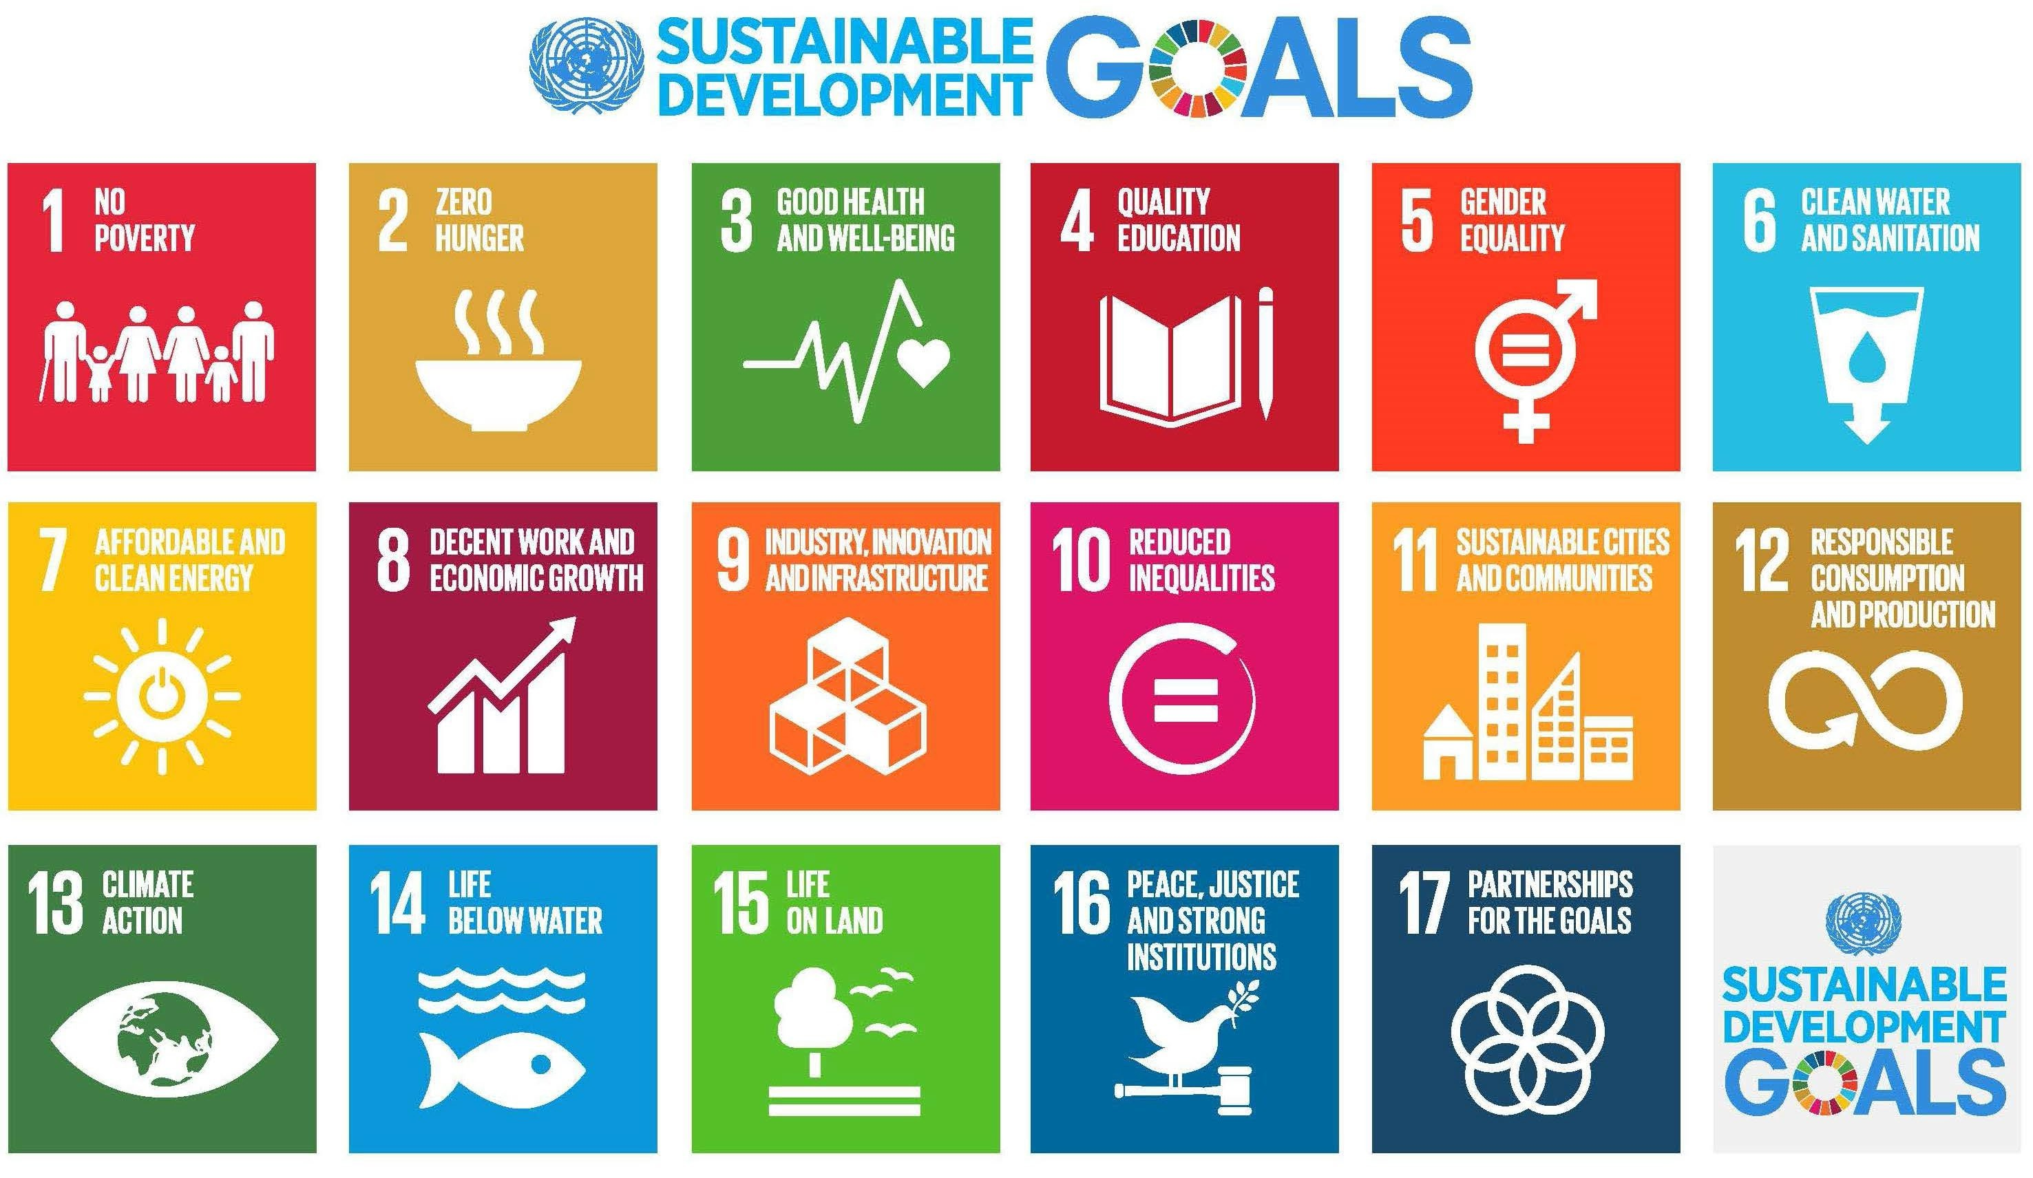
-

Slide 15

What’s needed? Who says?
What’s assumed? Ethics?
WHY?

Slide 16

WHAT?
Problem: What’s wrong?
Impact: What changes?
Proof: What demonstrates the change?
Budget & Resources: What support?
Project / Information management: What processes?

Slide 17

Example types of evidence
Testimonials
‘Data’ (survey, service access…)
Policy citation
Practitioner guidance change
Organizational reports
Surveys / evaluations
(ie. something that proves the change)

Slide 18
HOW?
Think…..
Engagement
Coproduction
Knowledge mobilization
Communications (e.g. online, press, newsletters, meetings, books etc)
Activities (seminars, workshops, consultations etc)
Implementation planning (opportunities, challenges etc)
But there may be barriers, obstacles, time lag and opposition

Slide 19





WHO?
Within a research organization including
Research staff, leadership, impact leads, comms, public engagement, research office, policy…..(etc)
Beyond the research organization including
Patients
Carers
Families
Staff
Partnership agencies
Audiences
Beneficiaries
Commissioners
Policy makers
Funders
Wider stakeholders
Don’t forget
Competitors
Opposition

Slide 20
Summary
Impact is the provable benefits of research in the ‘real world’
Impact literacy is the understanding of impact in terms of
  WHY change is needed
  WHAT the problem and therefore the necessary impact is
  WHO needs to be involved
  HOW research can be used to generate change.
Engagement with stakeholders outside of research is crucial to understand what matters
Evidence is needed to ensure claims are corroborated

Slide 21
II-Engaging and working with users of research
Content
A section focused on identifying stakeholders, considering how to engage them, and developing appropriate and effective ways to work together.
Learning outcomes
To understand the importance of stakeholder engagement
To understand the opportunities and challenges for stakeholder engagement
To be able to identify appropriate and effective ways to engage with stakeholders

Slide 22





Engagement
Why
the purpose
How
the methods
Who
the ‘audience’
What
can be mobilised
Remember: Engagement for impact

Slide 23
Engagement and fundamental research
‘Longer road’ to impact
Engagement may not be with ultimate beneficiaries; may be with (eg) companies, regulators, applied counterparts etc
Support a pathway to use.

Slide 24


Why engage?

Slide 25
Question
Why should we engage stakeholders in research?

Slide 26
Why engage?
To understand
what’s needed
the opportunity
To identify
‘market readiness’
(and embed) values
To find
a research partner
a translation partner
To explain
To set up an
implementation path
As a duty
Practical
  Ethical
To fuel
Onwards research use
  Societal use
To build trust

Slide 27
Who?

Slide 28
WHO includes…..
Businesses (Global to small enterprise)
Charities
Regulators
Voluntary organisations
Community organisations
Policy makers
Patients, carers
Public(s)
Arts venues
Commercial/production partners
Professional Bodies
Audiences
Commissioners
Funders
Discipline
Anyone / group / organisation who can support trajectory towards use
Question: Who do you engage with?

Slide 29
What?

Slide 30
What can be mobilized?
New knowledge, insights or evidence (‘we now know’)
New concepts, ideas or perspectives (‘we have rethought’)
Insights into ways things are understood (‘we know how we know’)
New or modified research methods (‘we know how to’)
Experiences of what doesn’t work (‘we know not to’)
A materially usable ‘thing’ such as a process, tool or intervention (‘we now have a thing for’)
A new practice or way of performing (‘we have a new way to’)
Newly heard voices, especially through coproduction (‘we’ve now heard from’)
A new definition or set of parameters (‘we can now specify’)

Slide 31

How?

Slide 32
Question
What makes it difficult to engage stakeholders in research?

Slide 33
Barriers include…..
Time
Jargon
Engagement incompletely reported; unclear exactly ‘what works’
Ambivalence or seen as unnecessary Nervous about getting it right
Concerned about negative effects on research

Slide 34
Question
What makes it easier to engage stakeholders in research?

Slide 35
Facilitators include….
Strategic commitment Institutional engagement Guidance
Skills development Showing what works
Clarity on roles and expectations Practical support

Slide 36



Some mechanisms for ‘how’
Dissemination and communication, websites, blogs, seminars, outreach, engagement (etc
Mobilizing research
Eg. outward secondments, knowledge transfer partnerships, ‘in residence’
Mobilizing researchers
Mobilizing non- academics
Eg. inward secondments, ‘artist in residence’, use of University labs

Slide 37
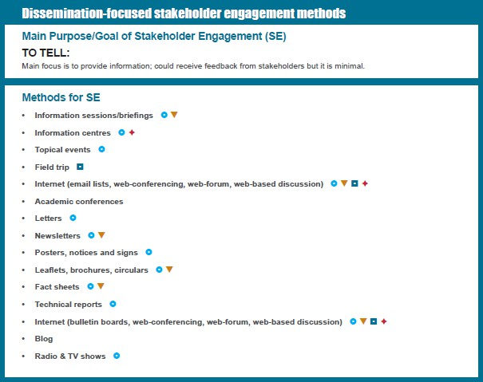
t

Slide 38
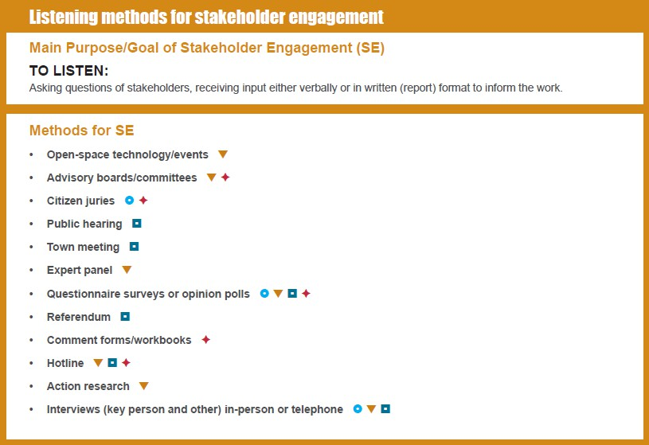

Slide 39
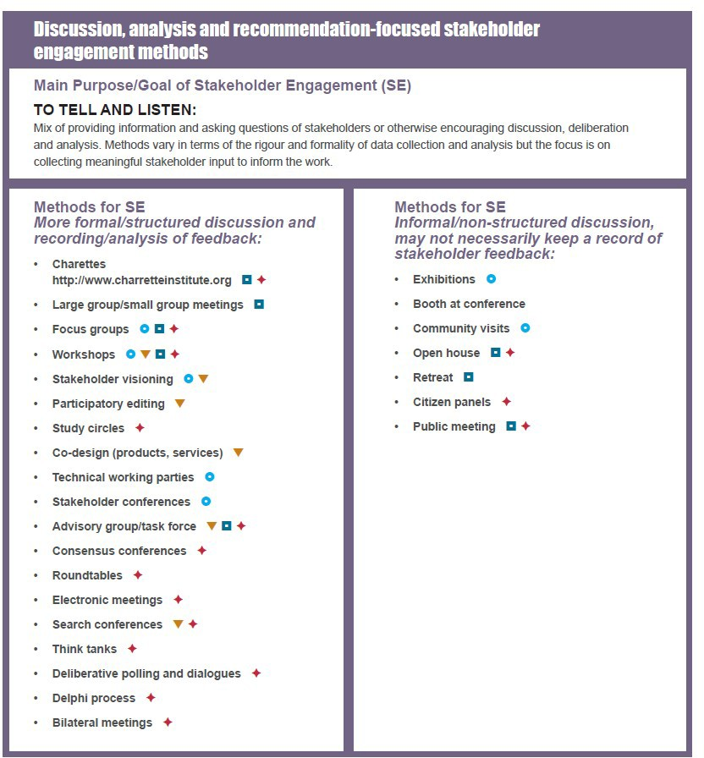

Slide 40
To conclude
Engagement is the act of building connections and relationships with people / groups / organizations throughout the research process
Who you need to engage with will always depend on the nature of the research, the extent it is ‘ready-to-apply’, and other contextual factors
There is no one size fits all; engagement is about understanding how the research contributes to real world change, how it can be used, and how it can be used most effectively.

Slide 41
III Demonstrating impact
Content
This section focuses on impact indicators, the ways in which impact can be corroborated, quantitative and qualitative methods which can be used to demonstrate effects, and the types of evidence commonly used
Learning outcomes
To understand the need for evidence
To understand different ways in which impact evidence can be generated
To be able to identify appropriate forms of evidence

Slide 42



Demonstrating impact
Why do we need to demonstrate impact?
What are you looking for?
How can you find it and prove it?

Slide 43

Question
Why do we need to demonstrate impact?

Slide 44






Why do we need to demonstrate impact? Includes….
To avoid assuming (or unrealistically claiming) contribution
To understand what
changes
To be accountable (particularly for public funds)
To ensure we’re reflecting effects felt outside academia
To showcase the contribution of research to society
To comply with regulations and requirements

Slide 45
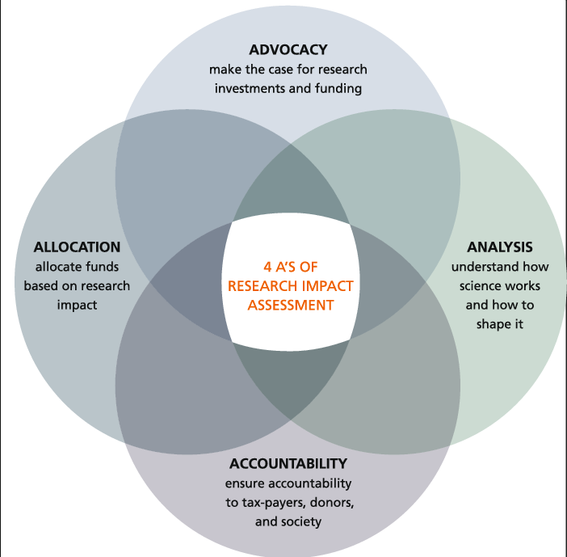
Why do we need to demonstrate impact? Includes….

Slide 46

What are you looking for?

Slide 47

Establishing forward?
Looking back?

Slide 48
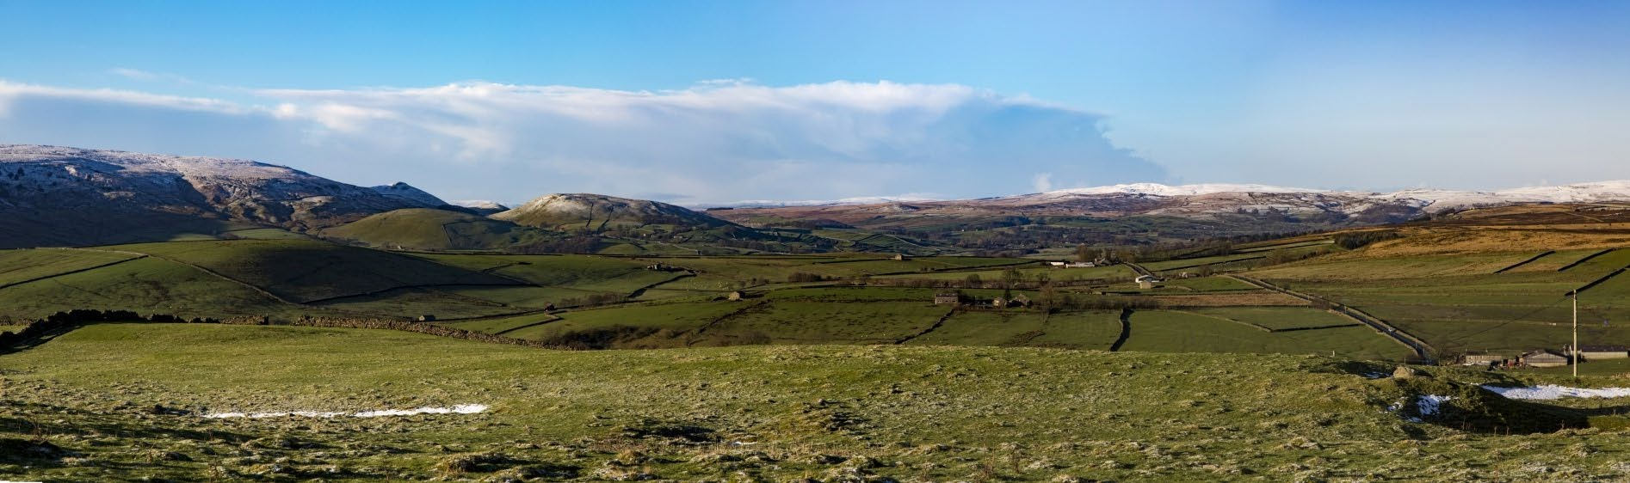




What are all the impacts our research achieves?
What impact has our research had on specific SDGs / health / the environment / regional economy etc

Slide 49
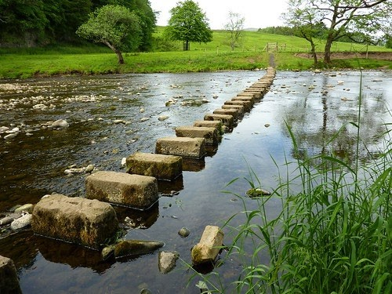
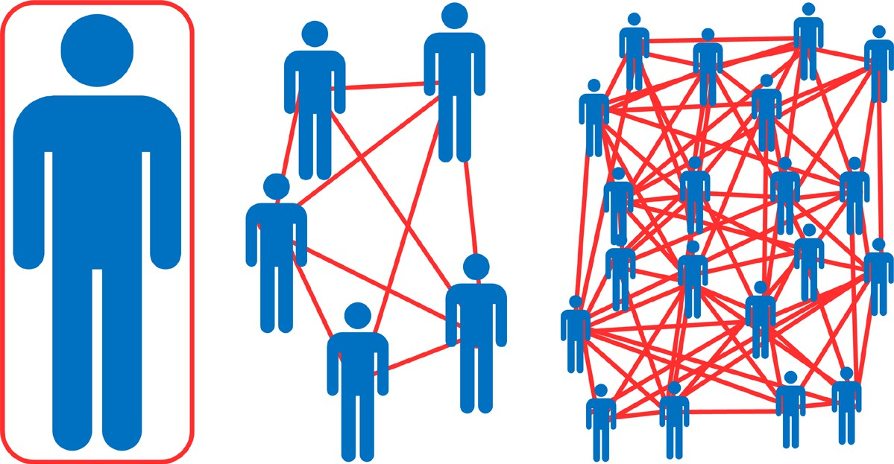

Impact and fundamental / theoretical research
Informs the onward steps of others
Takes a series of steps towards impact
Further research
Increasingly higher TRLs
Raises awareness
YOUR RESEARCH

Slide 50
How can you find and prove it?

Slide 51
Question
What kinds of evidence could you gather?

Slide 52
Evidence of impact
Evidence is used to ensure impact claims are accurate, corroborated and verifiable.
Evidence can be qualitative or quantitative
Evidence usually consists of several pieces which collectively corroborate the claim(s)
Often needs ‘eyes’ in the sector

Slide 53
Example types of evidence
Testimonials from third parties
Organisational reports
‘Data’ (eg. sales figures, visitors, service access, change in audience…)
Policy citation
Practitioner guidance change
New standards
Surveys (eg. after engagement events)
‘Swift exit’ methods, such as dropping a token or voting card in a box
Other people’s / researchers’ evaluations
ie. something that corroborates the real world change

Slide 54
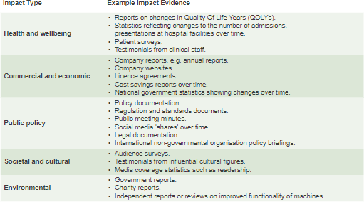
Example types of evidence

Slide 55
Levels of proof
Hard proof: There is no doubt
Softer proof: Provable when combined
Proxy measures: It indicates but doesn’t prove
Logic: Proof by elimination

Slide 56
Hard proof: There is no doubt
Where possible this should be the first point of call for any evidence claim.
Categorical link between your research and the impact. Examples include:
Citation in a new or changed policy (showing your research somehow materially contributed to the thing that now exists)
Sales figures for the widget you designed (showing the company profited by selling the thing that didn’t exist before your research)
Practitioner feedback saying ‘because of this research we were able to change
our service….’

Slide 57
Softer proof: Provable when combined
Where there is no hard evidence / claim can’t be substantiated by single piece of evidence, add together:
Proof of connection
Proof of effect (impact)
What shows there is a link between our research and the impact claimed?
Eg. workshops, performances, policy engagement (etc)
What impacts arise from these connections?
Ie. the change(s)

Slide 58
Proxy measures
It indicates but doesn’t prove
Insight into what the impact could be, but stop short of legitimating the actual claim. Examples include:
Engagement figures, eg. audience numbers giving a sense of the size/location/nature of audience
Gatekeeper accounts: Those in a position to offer comment on the ‘beneficiaries’ behalf, such as carers, teachers, venue managers, employers….
  “My students are looking into STEM as a career choice now….”
  “Our visitors are telling us….”
  “My staff are much more confident now…”

Slide 59
Logic (elimination)
If you really can’t get evidence, then you may need to rely on elimination logic ie:
“The impact could not have been possible without our research”
Relies on discounting other explanations for the impact, so can be risky

Slide 60

Hunt for impact
Ask researchers how the research has, or is likely to be used.
Ask external partners how the research has been used.
Follow citation paths; although citations aren’t impact, they can show you the onward path towards application. A useful tool is Connected Papers | Find and explore academic papers
Check if the work is cited in policies.
Check if there are any patents, or related intellectual property records which your research has influenced
Check mentions on media/social media

Slide 61
To conclude
Demonstrating impact is about articulating and corroborating real world changes
Quantitative or qualitative measures
Single evidence, or several pieces in combination
Helpful to have a frame of reference to focus your evidence gathering
Lots of resources and precedents within the sector

Slide 62
IV-Developing an impact strategy
Content
This section focuses on developing an institutional impact strategy, including identifying areas of impact, opportunities for knowledge mobilization and implementation, culture change, embedding a healthy institutional culture, and reflecting contextual barriers and facilitators.
Learning outcomes
To understand the need for a strategy
To identify the aspects of a healthy impact culture
To be able to identify culture change challenges/opportunities
To be able to construct an impact strategy

Slide 63
Developing an impact strategy
Content
This section focuses on developing an institutional impact strategy, including identifying areas of impact, opportunities for knowledge mobilization and implementation, culture change, embedding a healthy institutional culture, and reflecting contextual barriers and facilitators.
Learning outcomes
To understand the need for a strategy
To identify the aspects of a healthy impact culture
To be able to identify culture change challenges/opportunities
To be able to construct an impact strategy

Slide 64
Developing an impact strategy
Your strategy is your declared commitment to the importance of driving real world change through research
(and there’s no single way to do it)

Slide 65

Basic content of an impact strategy
Scope of strategy
What is impact, what does / doesn’t this strategy relate to
Mission or vision
Your overall goal, what you’ll be recognised for, what you’ll
change
Values
Any ethical, or strategic principles which guide you
(Approach)
Any stance you wish to take about
how you will do this
Roles and responsibilities
Strategic objectives
Measures of success

Slide 66
Scope of strategy
Mission or vision
Our mission is to be an institution that works in partnership with
society to drive change for policy,
practice, and people.
Our vision is of a economically stable and culturally rich region
Values
We believe we should help people, communities and organisations through research, and we should do that by working in partnership
In line with sector definitions of impact, the University defines impact as the provable effects (benefits) effects of
research in the ‘real world’. This strategy specifically focuses on
changes arising from research, rather than wider institutional activities
(Approach)
We recognise, but are not led by, external assessment and funding
agendas.
Our approach celebrates the varied skills and expertise across the
institution
Strategic objectives
To achieve our vision we will focus on 4 strategic objectives:
1) Prioritise problem focused research…..
Roles and responsibilities
This strategy is overseen by
<ROLE>
Measures of success
Increased partnerships Higher scoring case studies
More demonstrable impact on our region
etc

Slide 67
Impact Literacy
HOW
Approach
Implementation Engagement and research
translation
Impact Literate Strategy
WHAT
Scope Mission/vision
WHY
Values
WHO
Roles and Responsibilities
Partners & stakeholders
Strategic Objectives Measures of Success
Resources

Slide 68
Decide where
you want to go
STRATEGY
Establish your
starting point
Decide how you
will get there
IMPLEMENTATION
PLAN
How?
Consultation & engagement Internal & external
Needs, strengths, weaknesses, threats, opportunities, aspirations, requirements
+
Institutional Health

Slide 69






Establish your starting point
Existing impact strengths
Existing non-academic partnerships / relationships
Existing ways to engage?
Staff knowledge, skills and motivation
Existing institutional strategies, policies and requirements
What are you good at?
Who do you work with?
How do you work with them?
How well are staff engaged?
How is impact currently reflected in the institution’s structure?

Slide 70




Representative and inclus ive
Academics, research managers, leadership, early caree r, community partners, businesses, key funders etc
Consultation (internal and external)
Common methods: Focus groups , Ins titution wide s urve y, Inte rvie ws
P lus
Strategy deve lopme nt group
Explore s tra tegie s from comparator ins titutions
Review of sector drivers (eg. key funders)

Slide 71
Decide where you want to go…
Miss ion and vis ion
Strategic obje ctives
Me asures of success
…and how you ’ll get there
  Approa ch
Imple mentation
  Va lue s
Role s and respons ibilitie s
  Resources

Slide 72


Embedding healthy practice:
The 5 Cs of Institutional Impact Health

Slide 73

COMMITMENT
Th e e xte n t to th e re ’s com m itm e n t to im p a ct th rou gh s t ra te gy, s ys t e m s , s t a ff
d e ve lop m e n t a n d in te gra t in g im p a ct in to re s e a rch a n d e d u ca t ion p roce ss e s .

Slide 74

CLARITY
How cle a r ly s ta ff u n d e rs ta n d im p a ct, h ow im p a ct e xte n d s b e yon d t ra d it ion a l
e xp e cta t ion s of a ca d e m ic re s e a rch , a n d th e ir role in d e live r in g im p a ct

Slide 75
CONNECTIVITY
Th e e xte n t to wh ich u n it s work toge th e r, h ow th e y con n e ct to a n ove ra ll s t ra te g y, a n d h ow coh e s ive th e s e con n e ct ion s a re .

Slide 76
COMPETENCIES
Im p a ct- re la te d s kills a n d e xp e rt is e , d e ve lop m e n t of th os e s kills a cros s
in d ivid u a ls a n d te a m s , a n d va lu e p la ce d
on im p a ct - re la te d s p e cia lis m s .

Slide 77
COPRODUCTION
Th e e xte n t of, a n d q u a lit y of, e n ga ge m e n t with n on - a ca d e m ics for to ge n e ra te
im p a ctfu l re s e a rch a n d m e a n in gfu l e ffe cts

Slide 78
Healthy approaches
Create, value and support the space needed
Acknowledges effort
Invests in capacity/skills
Coordinates internal teams and resources
Clear roles and strategy.
Continually learns from best practice
Builds strong connections with external stakeholders.
Impact embedded and aligned (‘business as usual’)
Impact delivered by confident, impact literate staff within a positive impact culture.

Slide 79
Unhealthy approaches
Compartmentalised and disconnected impact
Singular responsibility
No space to embed into process; left to the end
Expects – but does not invest – in staff abilities.
No strategy.
Staff reluctant, unclear or unconfident
Few or superficial connections to external stakeholders.
Impact culture is negative, non-existent or treated as compliance with assessment/external mandates only.

Slide 80
Summary
An impa ct s tra tegy decla res your vis ion, approach, principle s and obje ctive s for real world change
Astrategy should encapsula te , a t a high le ve l, who you are/will be as an ins titution in impa ct
An impa ct lite rate approach reminds you to explicitly cons ide r why, who, how and what
Consulta tion and engagement is KEY to deve loping a robust, achie vable and accepted s tra tegy
Astrategy headline s commitme nt; an imple mentation pla n deta ils how tha t will be achie ved

Slide 81





Centre de Recerca en Economia i Desenvolupament Agroalimentari (CREDA)
Thank you!
Tel + 34 935 521 124 | E-mail: creda@creda.es
Subvencionat pel Departament d'Empresa (Programa
Primer) i amb el cofinançament del Fons Social Europeu Plus

