Slide 1



Impuls AgriTech Call 2025
Opportunity Analysis
Xavier Arola
Subvencionat pel Departament d'Empresa (Programa
Primer) i amb el cofinançament del Fons Social Europeu Plus

Slide 2
Opportunity Analysis
RECAP SESSION - 1

Slide 3
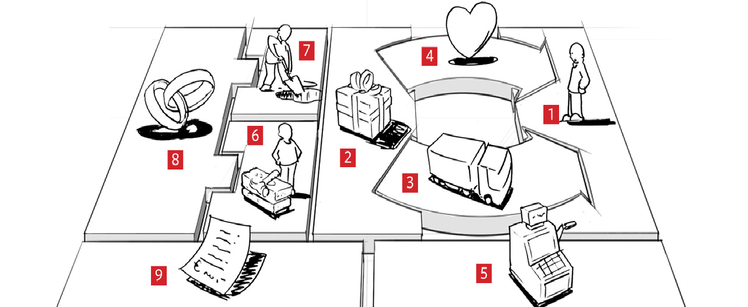
DEVELOPING YOUR BUSINESS MODEL
  YOUR IDEA
  YOUR MARKET SEGMENTATION
  YOUR BEACHEADED MARKET
  YOUR BUYER PERSONA
  (Through the Empathy Chart)
FROM THE WHY
TO YOUR
VALUE PROPOSITION CANVAS

Slide 4

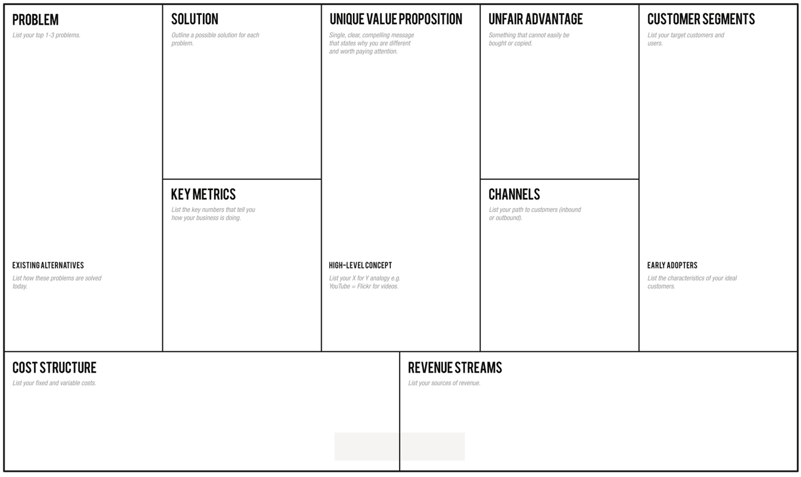
Opportunity Analysis
LET’S FOCUS ON
https://canvanizer.com/new/lean-canvas

Slide 5
Opportunity Analysis
So we have our WHY, our IDEA, is that ENOUGH?
BEFORE GOING FURTHER
LET’S UNDERSTAND IF
THAT IDEA IS AN OPPORTUNITY...
https://www.youtube.com/watch?v=NyPsP8sus8s

Slide 6

Opportunity Analysis
TIMING
LET’S IDENTIFY WHY TIMING IS OK IN OUR VENTURE…

Slide 7
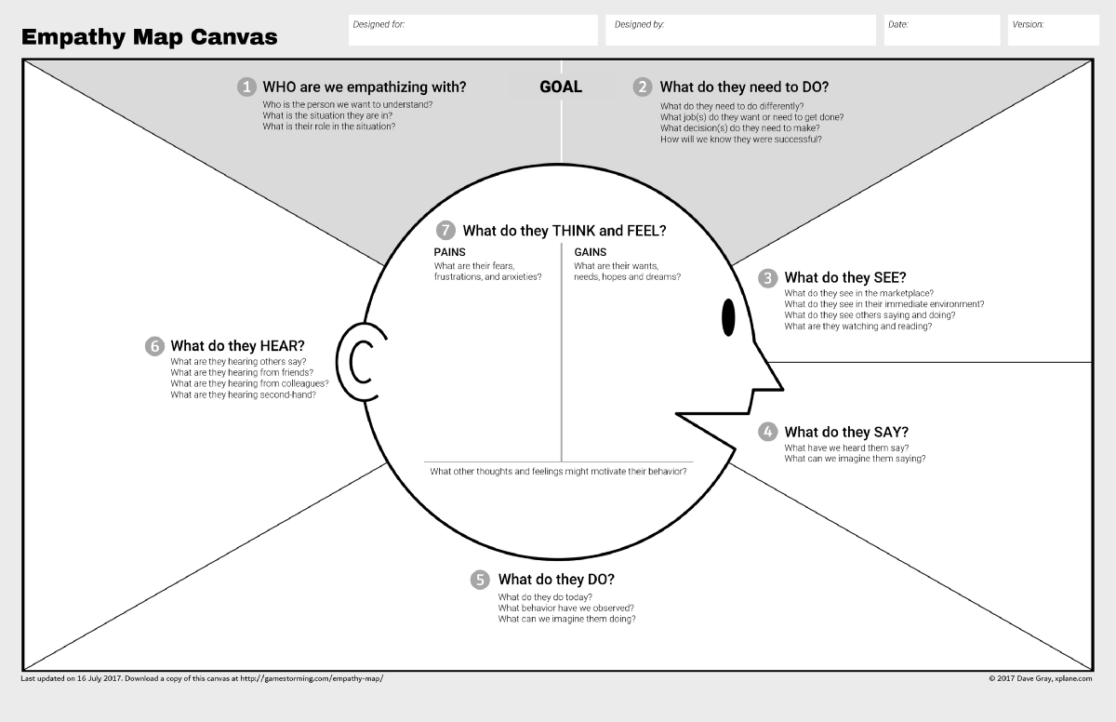
Opportunity Analysis
CHECK IF THEY HAVE A REAL PROBLEM…
BUT BEFORE DOING THAT LET’S LOOK CLOSER TO
OUR CUSTOMER
EMPATHY CHART

Slide 8
Opportunity Analysis
“Well, as a user, I wouldn’t do that.”
“Our users aren’t going to worry about that.”
“It’s my project. I know what users think.”
USER- CENTRIC SKILLS

Slide 9
Opportunity Analysis
EMPATHY CHART
Step 1: Establish Focus and Goals
Who is the person for the map?
What is the desired outcome?
Step 2: Capture the Outside World
What does she SEE?
What does she DO and SAY?
What does she HEAR?
Step 3: Explore Inside the Mind
What does she THINK and FEEL?
Step 4: Summarize and Share
PERSONA PROFILE
a session that reveals more questions than answers indicates where more user research needs to be done.

Slide 10
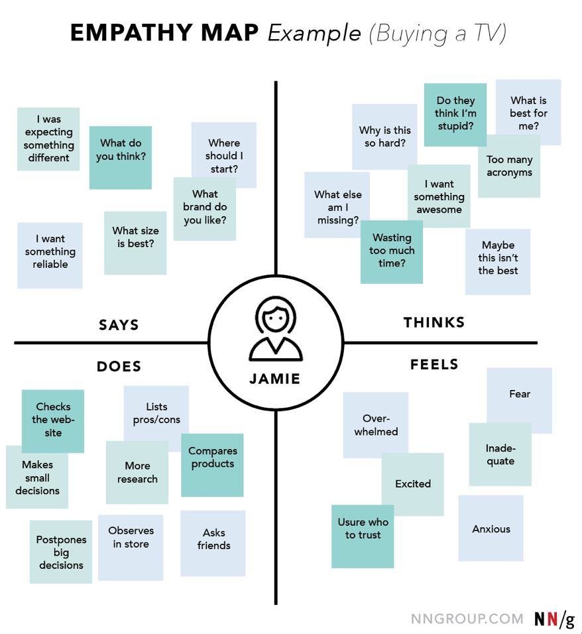
Opportunity Analysis

Slide 11
Opportunity Analysis
EXERCISE 5) EMPATHY CHART

Slide 12

Opportunity Analysis
CHECK IF THEY HAVE A REAL PROBLEM…
BUT BEFORE DOING THAT LET’S LOOK CLOSER TO
OUR CUSTOMER
EMPATHY CHART/ DIAGRAMA PERSONA

Slide 13
Opportunity Analysis
PROBLEM / SOLUTION
  KEY QUESTIONS
  What value do we deliver to the customer?
  Which one of our customer’s problems are we helping to solve?
  Which customer needs are we satisfying?
  What bundles of products and services are we offering to each Customer Segment?

Slide 14
Opportunity Analysis
And then with this persona profile we can focus on
The problema /solution
perspective…

Slide 15
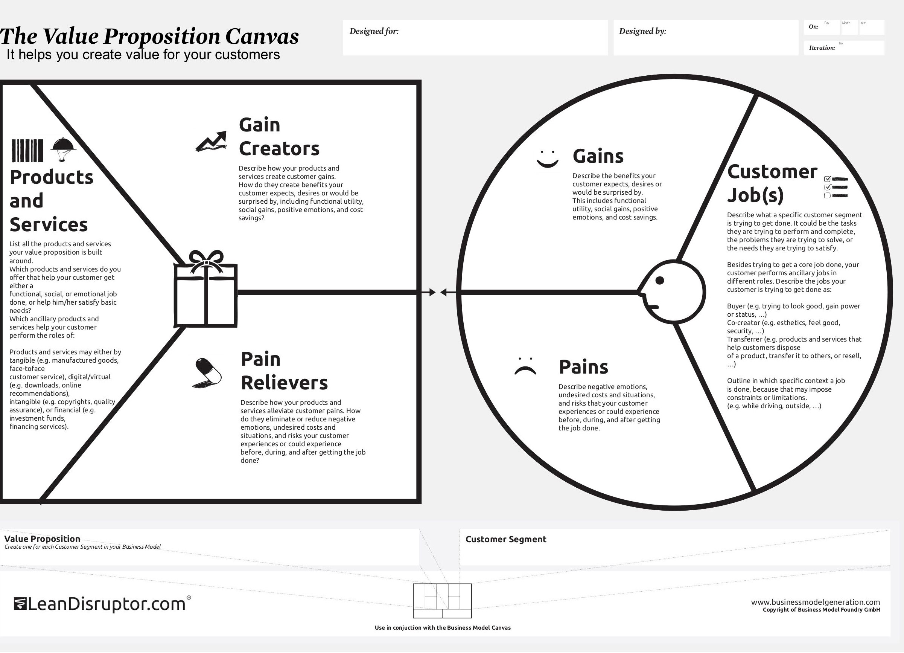
Opportunity Analysis
LET’S CHECK CUSTOMER
WITH VALUE PROPOSITION
TRHOUGH
THE
VALUE
PROPOSITION
CANVAS

Slide 16
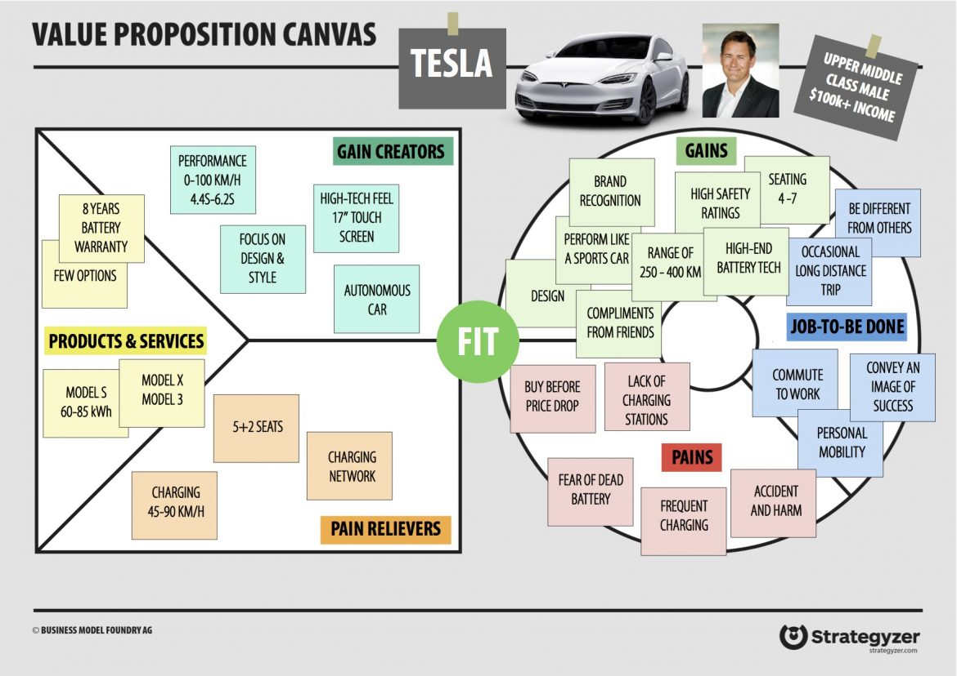
Opportunity Analysis
EXAMPLE

Slide 17
Opportunity Analysis
EXERCISE 6) VALUE PROPOSITION CANVAS

Slide 18
Opportunity Analysis

Slide 19

Opportunity Analysis
Let’s identify our inovativness
DEFINE YOUR INNOVATION PROCESS
https://www.ideatovalue.com/inno/nickskillicorn/2016/03/innovation-15-experts-share-innovation-definition/

Slide 20


Opportunity Analysis
AND THEN…
THE DIFFERENTIATION OF OUR VALUE PROPOSITION
Let's dig into the deepness of our potential Market and the easiness to achieve it and growth (Scalability)

Slide 21

Opportunity Analysis
WHAT IS IT THAT DIFFERENTIATES THE COMPANY FROM THE REST OF THE MARKET IN THE EYES OF THE CUSTOMERS?

Slide 22
Opportunity Analysis
THEN LET’S REDEFINE THE PROBLEM WE ARE SOLVING ACCORDING TO YOUR END USER PROFILE…

Slide 23
Opportunity Analysis
About differentiation let’s understand our competitive advantage:
Ocean Blue
Analysis
Competitor's
Analysis

Slide 24
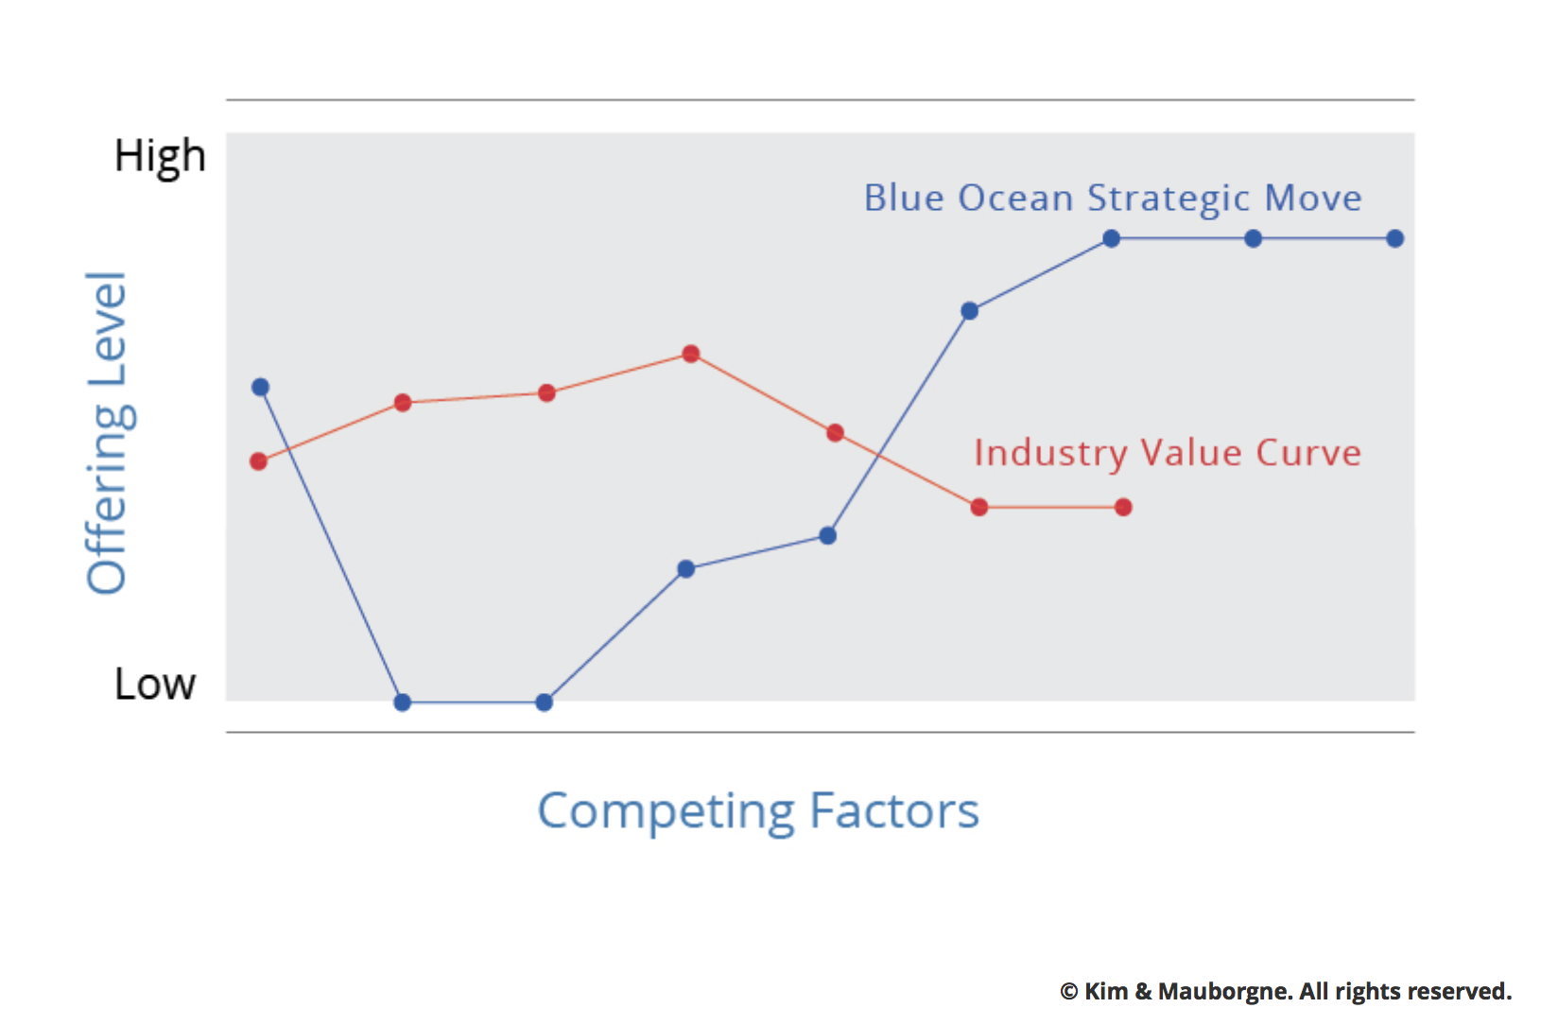
Opportunity Analysis
About differentiation… let’s understand our competitive advantage: UNFAIR ADVANTAGE
OCEAN BLUE ANALYSIS

Slide 25
Opportunity Analysis
First step
COMPETITOR’S Analysis

Slide 26
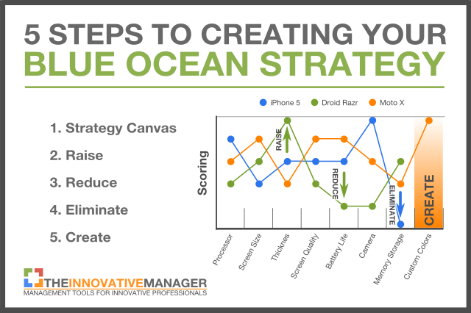
Opportunity Analysis
OCEAN BLUE ANALYSYS (example)
Step 1: Create A Strategy Canvas
Step 2: Raise An Attribute
  Raise
  Reduce
  Eliminate
  Create
Step 3: Reduce An Attribute
Step 4: Eliminate An Attribute
Step 5: Create An Attribute

Slide 27
Opportunity Analysis
EXERCISE 7) OCEAN BLUE CANVAS

Slide 28
Opportunity Analysis
COMPETITOR’S ANALYSIS XLS
Competitors Analysis.xls

Slide 29
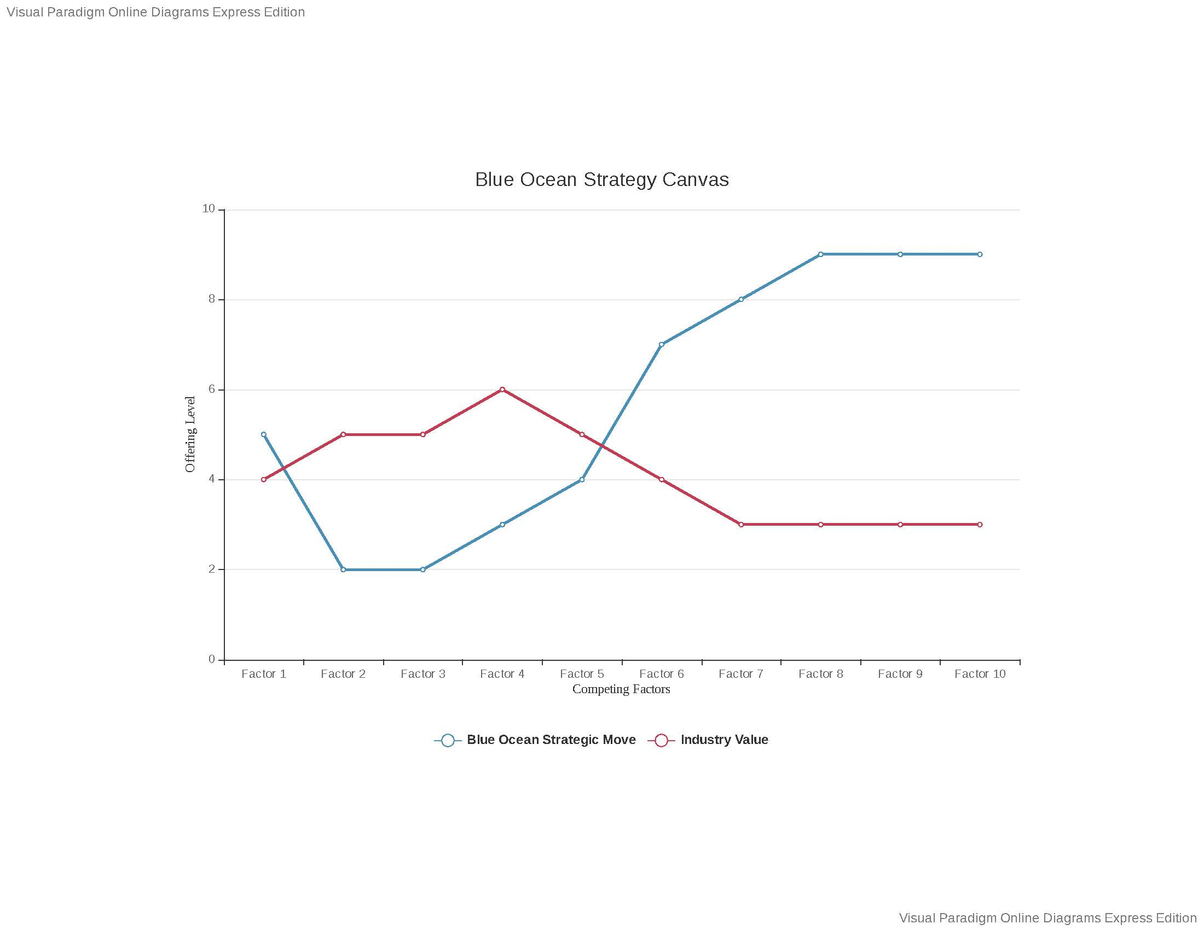
Opportunity
Analysis

Slide 30
Opportunity Analysis
And now…. The size…. How big is your market…?

Slide 31
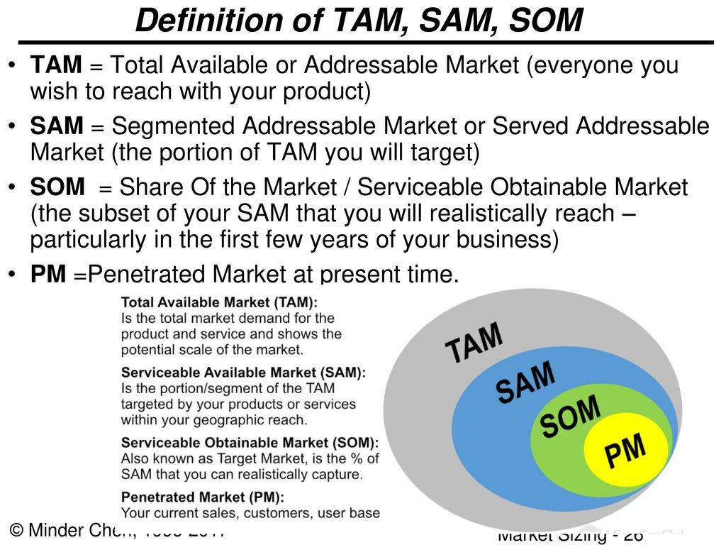
Opportunity Analysis
And then which piece of cake we could realistically to get
TAM, Sam, SOM concepts

Slide 32
Opportunity Analysis
And then is time for the second part of the canvas
First approximation:
INCOMES
Revenue Model
LTV
Revenue
Gross margin
…

Slide 33
Opportunity Analysis
Some tips about revenues….
Defining
Types of Revenue Streams
  Transaction revenues resulting from one-time customer payments
  Recurring revenues resulting from ongoing payments to either deliver a Value Proposition to customers or provide post-purchase customer support
Pricing mechanisms, such as fixed list prices, bargaining, auctioning, market dependent, volume dependent, or yield management.
Payment Conditions, cash, 30-60-90 days
Discounts / offers policy / membership conditions

Slide 34
Opportunity Analysis
There are several ways to generate Revenue Streams:
ASSET SALE: selling ownership rights to a physical product. i.e AMAZON
USAGE FEE: generated by the use of a particular service. i.e Hotels / telecos
SUBSCRIPTION FEE: generated by selling continuous access to a service. gyms
LENDING/RENTING/LEASING: created by temporarily granting someone the exclusive right to use a particular asset for a fixed period in return for a fee. i.e Avant car.
LICENSING: generated by giving customers permission to use protected intellectual property in exchange for licensing fees. i.e Publishing company.
BROKERAGE FEES: derives from intermediation services performed on behalf of two or more parties. i.e Brokers and real estate
ADVERTISING: results from fees for advertising. i.e Facebook.

Slide 35
Opportunity Analysis
And then is time for the second part of the canvas
First approximation:
COST
CAC
Distribution Costs
Hosting
People, etc

Slide 36
Opportunity Analysis
Some tips about costs….
you must consider the most important costs to your business and create hypotheses for these expenses.
you must distinguish between initials cost to start your business (INVESTMENT PLAN) and the operating and recurrent costs of your activity (COSTS and OPERATIONS)
You will need to take into account both fixed costs, such as startup and acquisition costs, and variable costs, such as your monthly operating costs.

Slide 37
Opportunity Analysis
Can we scalate it? How we adress to the Customers CHANNELS?
1. Ask Yourself If Your Business Is Really Scalable
2. Identify Your “Core”
3. Automate or Outsource Everything You Can
4. Make Your Business Workable Without You
5. Don’t Go Overboard in These Key Areas
Hiring
Spending
Building
Scalable it means that your business has the potential to multiply revenue with minimal incremental cost
(synonimous of investeable):
As you plan for the next phase
of your company’s development,
remember these five tips for a
successful scale-up.

Slide 38
Opportunity Analysis
What You Need to Remember
Figure out how to automate or outsource everything you possibly can, especially if it’s not directly related to your core competencies.
Stay disciplined with your money. Don’t spend on new people or features until you’re absolutely ready to do so.
Make sure your business is actually scalable. There’s nothing wrong with staying small and lean if the product or service demands it.

Slide 39
Opportunity Analysis
Again…. 10 tips for the most scalables start up according FORBES
https://www.forbes.com/sites/martinzwilling/2013/09/06/10-tips-for-building-the-most-scalable-startup/?sh=c39741c5f28d

Slide 40
Opportunity Analysis
And of course… the management control:
The Key Metrics/activities
And the ROADMAP to follow.

Slide 41
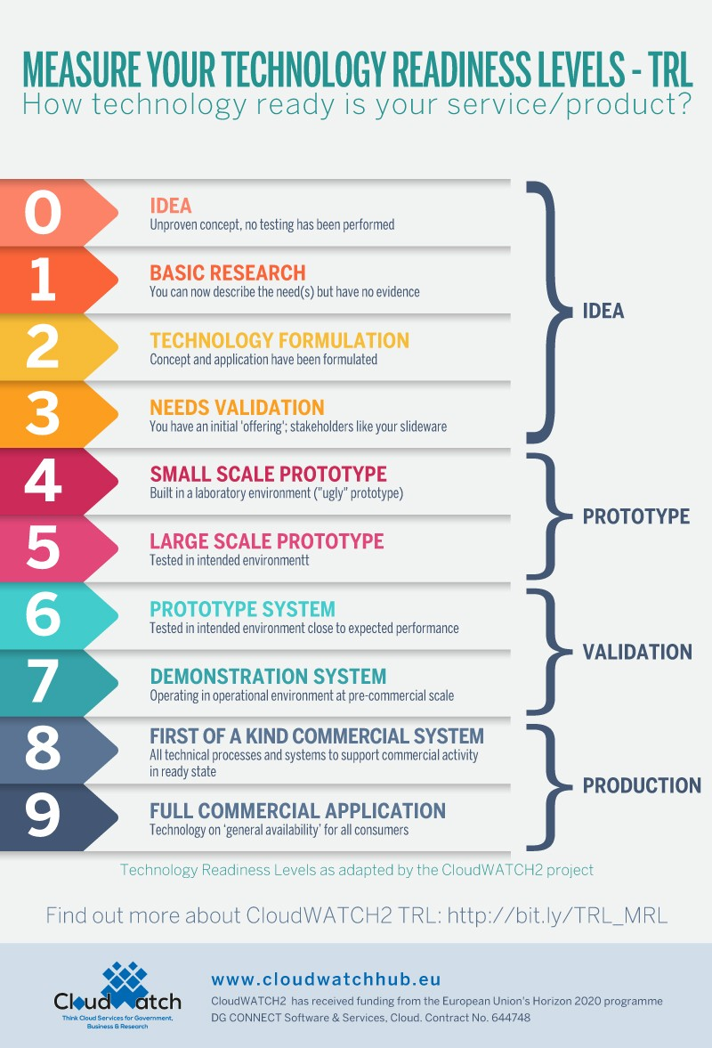
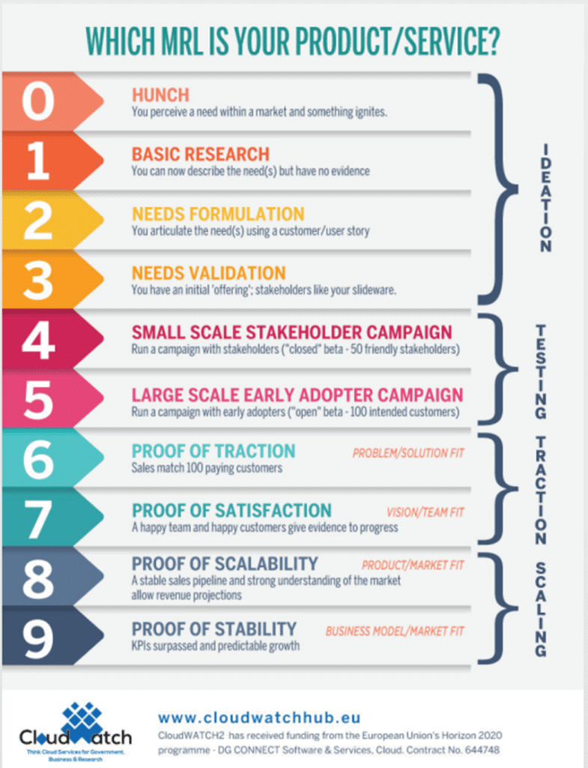
Opportunity Analysis
The starting point

Slide 42
Opportunity Analysis
And the ROADMAP

Slide 43
Opportunity
Analysis
Let's have some AI now….
AI Innovation Platform

Slide 44
Opportunity Analysis
SUMMARY – RECAP
Why the Lean Start-Up Changes Everything
https://hbr.org/video/5712986167001/why-the-lean-startup-changes-everything

Slide 45
G-ACCELERATOR Impact Call 2025
PLEASE FILL OUT COURSE SURVEY!!​
​
Course Survey
Subvencionat pel Departament d'Empresa (Programa ​
Primer) i amb el cofinançament del Fons Social Europeu Plus

